Slide 1

Introduction to Linux
Bash and Basic GNU/Linux and Unix Concepts

Slide 2

This class will….
Get your toes wet. Unix and Linux are gargantuan topics that only come into focus with experience.
Provide some basic concept information for users familiar with MacOS or Windows.
Get you familiar with Linux commands.
Get you started in understanding command line interfaces.

Slide 3
Class outline
History of Linux
Kernel and shells
The bash shell
Files and directories
File ownership and permissions
Essential Linux commands with exercises
File transfer
Processes
Compressing files
cron

Slide 4


History
Late 60’s through 1980’s
Unix is the result of Bell Labs research (Dennis Ritchie, Brian Kerningham, Ken Thompson, et al). Originally written in assembly language.
Unics (Unix) was named in contrast to MIT’s Multics operating system.
Berkeley Software Distribution (BSD), or Berkeley Unix derived from Bell Labs’ work in part due to government monopoly agreements.
Unix led to the BSD family of operating systems in the 1990’s.

Slide 5

History
Richard Stallman, in 1983
Started the GNU (GNU’s Not Unix!) project
Open-sourced versions of standard suite of Unix utilities found in BSD
GNU is also a software license – allows for code modifications as long as they are shared
Utilities used in Linux, BSD-derived and proprietary Unix operating systems
All commands in this lesson are from GNU

Slide 6
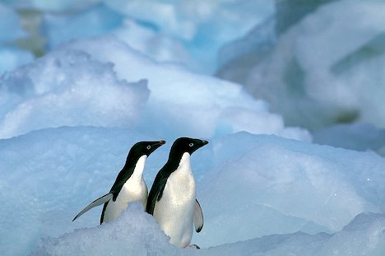
History
Linus Torvalds, in 1991
Released the first version of his Linux kernel.
Started as a study in processor architectures while at the University of Helsinki, Finland, and to this day still has the authority on what gets included in the Linux kernel
In 1992 adopted the GNU license and rapidly gathered developers
Combined the GNU suite of utilities with a new operating system kernel (GNU/Linux)

Slide 7

History
By the mid 1990’s/early 2000’s GNU/Linux starts to gather main-stream adoption, especially in research and academic circles due to structural similarities with Unix and BSD
Gains large market share of commercial servers
Becomes usable for desktop adoption
Present on gadgets (e.g. Android smartphones, home routers, car information systems, etc)

Slide 8








Popular Linux Distributions
Red Hat Enterprise Linux
CentOS
Fedora
Debian
Ubuntu
Suse Linux
Linux Mint

Slide 9
Linux in Science (why?)
Popular due to shared functional legacy with Unix systems associated with research (Irix, SunOS/Solaris, etc.)
Source code availability and semi-liberal licensing made it easy for researchers to adjust the kernel as needed.
Community backing and “perfect- storm” of enthusiasm for the project led to critical mass of development (in contract to the BSD family)
Licensing and well known Unix-style APIs make it easy for vendors of HPC equipment to write drivers for their hardware.
Wide range of tools available for users (compilers, scientific libraries, debuggers, etc).
Performance, functionality and portability

Slide 10
Concepts: Kernel
Operating system “kernel” is the core software used to “talk” to computer hardware
It’s a core and modular system of drivers used to create a standardized environment for interfacing with hardware
Resource manager for allocating memory and time to system and user processes as well as interacting with files (I/O)
Kernel operates in its own memory or “kernel-space”
Users
CPU
Kernel
Memory
Applications/processes
Devices

Slide 11
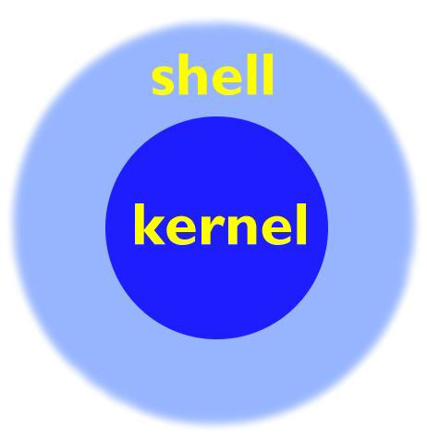
Your Shell
On user log-in, the system runs a shell
A shell is the environment within which you will interface with the kernel via commands
It determines the syntax for complex command-line operations and shell scripting
The shell you’re using is called “bash,” the successor to the venerable “Bourne Shell” called “sh”
BASH: “Bourne Again SHell”

Slide 12

Various Shells
sh – the original UNIX shell
bash – written as a replacement/extension of sh
csh – C shell based on the C programming language developed in the late 1970s
tcsh – enhanced version of C shell
ksh – Korn shell developed in the early 1980’s, backward compatible with sh, but with some features of csh
zsh – extended version of sh, developed in 1990
dash – developed as replacement for ash in Debian

Slide 13

Linux accounts
To access a Linux system, you need to have an account
A Linux account includes the following:
- username and password
- uid and gid
- a home directory, which is where you are placed by default when you log in
- a default shell

Slide 14

Using SSH to log in:
But First! Introducing OpenSSH:
SSH is the “Secure SHell”
All traffic over SSH is encrypted
Developed as a secure alternative to RSH and Telnet
SSH supports a file-transfer subsystem - SCP
SSH can act as an encryption layer for arbitrary network connections

Slide 15

Logging in
MacOS:
Finder -> Applications -> Utilities -> Terminal
Now type: “ssh username@helix.nih.gov”
At the prompt, enter the account password
Windows:
Launch PuTTY. Under “Host Name (or IP address), type:
username@helix.nih.gov
…and click “Open”
At the prompt, enter the account password

Slide 16
Logging out
DON’T run this now, but to log out of a ssh session on a Linux system, you would type exit:
$ exit

Slide 17
More on shells
What shell am I in? Typing “echo $SHELL” will show you!
You should see ‘/bin/bash’
Typing “echo $0” will also show your shell
$SHELL and $0 are shell variables…more about variables later
List of available shells on the system can be displayed by typing “chsh --list-shells”
The chsh command can be used to change your default shell as well, but on Biowulf & Helix never change it to a shell that ends in LOCKED, SUSPENDED, DISABLED – you will lock yourself out of your account!

Slide 18
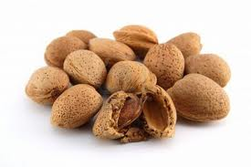
Shell preferences
When you login, startup scripts are run to setup your environment
For bash, you can customize your environment by adding or modifying environment variables and aliases in the .bashrc file in your home directory.
Examples:
alias ls=‘ls -rtl’
alias bwulf='ssh $USER@biowulf.nih.gov'
PATH=$PATH:/data/myusername
EDITOR=/usr/bin/vim
PS1="[\u@\h \w \# ]"
set -o noclobber

Slide 19
Summary of Linux commands
awk allows manipulation of text
bg place suspended job into background
cal display calendar
cat view contents of a file
cd change directory
chmod change permissions on a file/directory
cp copy a file
cut extract a field of data from text output
diff compare files line by line
echo output text to the terminal or to a file
emacs text editor
fg bring suspended job to foreground
file display file type
find search for files
grep search a file or command output for a pattern
head view beginning of file
history display list of most recent commands
less scroll forward or back through a file
ln create a link to a file
ls list files in a directory
man view information about a command
mkdir make directory
more scroll through file a page at a time
mv change the name of a file (move)
nano/pico text editors
printenv display shell variables
ps show current process information
pwd print current working directory
rm delete or remove a file
rmdir delete or remove a directory
sed stream editor
sleep pause
sort perform a sort of text
tail view end of the file
touch create an empty file or update timestamps
tr character substitution tool
uniq remove identical, adjacent lines
vi/vim text editor
wc print number of lines, words or characters
which shows full path of a command
whoami displays username

Slide 20
Our cast! (of characters)
Character | Name/Location
\ | Backslash (above the enter key)
/ | Slash (left of right shift key)
` | Back-tick (left of the number 1, above the tab key)
| | Pipe (shift-\)
[ and ] | Brackets (left of the backslash)
{ and } | Braces or “curly” brackets (shift-[ and shift-])
< and > | Angle brackets (left of the right shift key)
~ | Tilde (shift-~)
!, @, #, $, %,^, &, *, (, ) | (!) Bang/exclamation mark, (@) at sign, (#) hash, ($) dollar/string, (%) percent, (^) caret, (&) ampersand, (*) asterisk/start, and the left and right parenthesis.

Slide 21
Linux Command Basics
Linux commands are case-sensitive
ls is not the same as LS
Linux commands may have options that come after the command that start with a “–” and followed by a letter or “- -” and a word:
$ ls –r
$ ls --reverse
Linux commands may allow for arguments:
$ ls /tmp
You can run more than one command on the same line by separating the commands with a semicolon (;)
$ ls;date
Most Linux commands have a manual page or help to describe how they can be used….more about this later!

Slide 22
Linux Command Example
$ ls –r /home/$USER
prompt
command
option
argument

Slide 23

Exercise #1: First commands
[username@helix ~]$
Type “whoami”, press Enter – who are you?
Type “pwd”, press Enter – where are you?
Type “echo $HOME” – what does it show?
Type “echo $USER” – what does it show?
Type “echo $PWD” – what does it show?
$HOME, $USER and $PWD are three more examples of shell variables as we saw earlier with $SHELL

Slide 24

Concepts: Files and Processes
In Unix, and by extension, Linux, everything is either a file or a process. Meaning everything can be interfaced via the file system(s).
Files: text, data, documents, traditional files
Directories: directories are special text files that contain a bunch of other files
Devices: all disks, video hardware, audio hardware, processors, memory, USB ports – all hardware can be interfaced via files (usually in /dev)
Processes: all running processes can be “seen” via the file system (in /proc) – each has a unique identifier (PID)

Slide 25
More on Files
Each file (and directory) has a name
The filename can contain letters, numbers and special characters – best to start with name or number
Every file has a unique path to its location
Example: /home/student2/read-write.txt
A filename MUST be unique within a directory…though files with the same filename can exist in different directories
Like Linux commands, filenames are case sensitive so a file named “myfile” and “Myfile” can co-exist in the same directory – the names are different.
Filenames can be lengthy

Slide 26
More on Directories
A directory is a special type of file that can hold other files – often referred to as a folder in Windows or MacOS
The “working directory” is the directory with which your shell is currently associated…where you currently are! When you first login, you will normally be in your home directory, /home/username
Use the ‘pwd’ command to print working directory
Special directory notations:
. refers to the current working directory
.. refers to the parent directory (one level back – the parent directory of /home/username would be /home)

Slide 27
Pathname
Every file has a unique path to its location…for example:
/home/student2/Projects/docs/final_report.doc
‘/home/student2’ is the home directory for student2
‘Projects’ is a directory in /home/student2 - student2 is the parent directory of Projects
‘docs’ is a directory in ‘Projects’ – docs is a subdirectory or child directory of Projects
‘final_report.doc’ is a file in ‘docs’

Slide 28
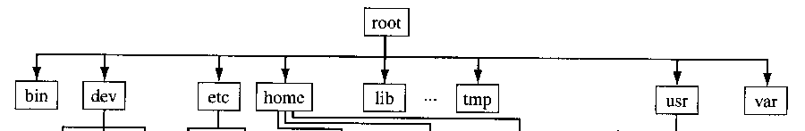
Concepts: The File System
Linux and Unix-like file systems are arranged in a tree structure, all with the same bottom level, called “root” (/).
Unlike Windows there are no drives, drive letters or any separate conceptual “space” for storage hardware.
New hardware will come in the form of a “file system” attached (mounted) to some arbitrary point in the directory structure.

Slide 29
Linux Directory Structure
/ root
/bin bare essential commands
/boot OS Kernels
/dev hardware devices
/etc system files, configuration
/home home directories
/lib Libraries needed by the system
/opt 3rd party applications
/proc Running processes
/sbin administrative commands
/tmp temporary space
/usr operating system applications
/var Logs, databases and other variable length stuff

Slide 30
cd and ls commands
The “cd” command is used to change directory location. Without an argument, “cd” takes you to your home directory
The “ls” command is used to list the files in a directory. Like many Linux commands, it can take a number of “flags” as options to change the behavior of the command
$ cd /home/$USER
$ ls
$ cd /etc
$ pwd
$ ls
$ ls –l
$ ls -rl
$ cd
$ pwd

Slide 31

Exercise #2: “cd” and “ls” commands
Type “cd /data/classes/linux”
Try “ls -l”
Try “ls -a”
Try “ls -la”
How are the above outputs different?
Type “ls –lt”
How is this output ordered?
Type “ls –l /tmp”
The above shows how providing an argument to the ‘ls’ command displays the contents of a directory without first changing to the directory
Type “cd /home/$USER” to change to your home directory
Now type “cd -”
To what directory did that take you?
Now type “cd ..”
To what directory dis that take you?
Type “cd /home/$USER” to get back to your home directory

Slide 32

Finding your way home!
The “~” is a special character that is short-hand for “/home/username”
The shell variable $HOME also stores the path of “/home/username”
Several ways to get to your home directory:
$ cd ~
$ cd $HOME
$ cd /home/username
$ cd /home/$USER
$ cd
But you can also use the “~” and $HOME as arguments with other commands:
$ ls ~/tmp
$ ls $HOME/LinuxClass

Slide 33
Absolute and Relative paths
The starting “/” in the directory argument explicitly spells out a pathname – specifying an absolute or full path
No leading “/” means you are specifying a path that is relative to the current working directory.
“cd /tmp” is different from “cd tmp”
$ cd /home/username
# Absolute path:
$ cd /home/username/tmp
# Relative path:
$ cd tmp
# Using ~
These do the same:
$ cd ~/tmp
$ cd /home/username/tmp

Slide 34
Help!
Many commands provide a ‘--help’ option which will display information on the various options and there means. For example:
$ ls --help
There is also the “man” command, which will provide a manual listing on the use of standard Linux commands such as ls one page at a time
$ man ls
One can scroll forward or back one line at a time using the up & down arrow keys and scroll forward or back one page at a time by hitting the ‘f’ or ‘b’ keys, respectively.
Exit out of a man page by typing ‘q’
Try both of the above commands

Slide 35
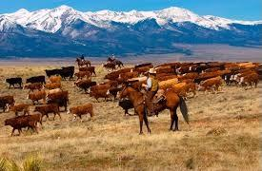
Users and Groups
Users are associated with a unique user identification (UID) number that the system uses internally
Users can be real people
Users can be system entities
Users can be herded via groups
Groups also are associated with a unique group identification (GID) number by the system
Groups allow multiple users to access/share the same files

Slide 36
Ownership & Permissions
Linux systems are multi-user environments that allow users to create files, run programs and share data.
Files and directories have two types of ownership – the user and group. A Linux group consists of one or more users.
Files and directories have three types of access permissions:
read permission (r)
write permission (w)
execute permission (x)
Every file and directory has permissions for three levels or entities of permissions:
a) user or owner (denoted by u)
b) group (one or more users – denoted by g)
c) others or world (denoted by o)

Slide 37
Permissions triplets
Each triplet indicates the access permissions for that level – in the example below, the user/owner has read, write & execute permission, other group members only have read and execute permissions and all others have no access permissions.
-rwxr-x---.
Owner attributes
Group
attributes
World
attributes
SELinux
File type

Slide 38
Long List Output Explained (a little)
From left to right:
Unix permissions
Hard links
Owner
Group ownership
File size in bytes
Modification date
Name of file
Special Directories:
. is the current working directory
.. is the “parent” directory, one level “back”
$ ls -la
drwxrwx--- 104 mark staff 110592 Aug 17 13:02 .
drwxr-xr-x 2510 root root 196608 Aug 17 12:58 ..
-rw-r--r-- 1 mark mark 1051 May 8 2016 ad-week
-rwxr--r-- 1 mark staff 239 May 11 2013 alias.pl
-rw-r----- 1 mark staff 1185 Jun 22 2014 bp.txt
-rwxr-xr-x 1 root root 27320 Mar 29 2015 getpass.awk
-rw-rw-r-- 1 david staff 20529 Aug 7 2017 httpd.conf
-rwxr--r-- 1 root staff 136236 Sep 10 2017 memcon
drwxr-x--- 2 mark staff 4096 Jun 24 2017 misc
drwx------ 3 mark staff 4096 Jun 24 2017 test
-rwx------ 1 mark staff 493 Feb 10 2016 unlock
-rw-r----- 1 mark staff 38 Oct 20 2017 world.c
-rwxr-x--- 1 mark staff 6703 Jan 8 2017 world.exe
-rwxrwx--- 1 mark staff 2350 May 22 2017 year.pl
lrwxrwxrwx 1 mark staff 7 Aug 16 15:30 year2 -> year.pl

Slide 39
Permissions described:
File Type:
Permissions
“-” regular file
“d” directory
“l” symlink
“b” block device
“c” character device
“p” named pipe
“s” socket
“r” read
“w” write
“x” execute
Special values:
“x” executable
“s” or “t”: executable and setuid/setgid/sticky
“S” or “T”: setuid/setgid or sticky, but not executable.

Slide 40
Changing Permissions and Ownership
Use ‘chmod’ to change the file permissions:
chmod [ugoa][+/-][rwx] filename
where u=user, g=group, o=others or world and a=all three
For example, to provide group read access to a file:
$ chmod g+r myfile
Or to remove file access to another than the owner or group members (in other words, others):
$ chmod o-rwx myfile
The ‘chown’ command is used to change file ownership and the ‘chgrp’ command can change group ownership of a file. As a regular user, you can not change the ownership of a file, but you can change the group ownership if you are a member of the group to which you are changing the group ownership
You can use the –R argument on any of the above to recursively make changes on a directory of files

Slide 41
Exercise #3 pre-exercise
We’ll talk about some of these commands shortly, but you each need to make a copy of files needed for the rest of class.
First go to your home directory
$ cd /home/$USER
Make a ‘LinuxClass’ directory for yourself and go into that directory:
$ mkdir LinuxClass
$ cd LinuxClass
Copy the files from the exercise file to your directory:
$ cp –r /data/classes/linux/* .
$ ls -l
Create a shell variable to your class directory:
$ class=$PWD
$ cd $class

Slide 42
Exercise #3: File Permissions
Read Permissions
Execute Permissions
The cat command displays contents of a file
$ cd /home/$USER/LinuxClass
$ cat read-write.txt
Change the read permission
$ chmod u-r read-write.txt
$ cat read-write.txt
What happened? Now restore the read permission
$ chmod u+r read-write.txt
$ cat read-write.txt
$ cd /home/$USER/LinuxClass
Run the myhostname file to see the system name
$ ./myhostname
Remove the execute permission for the user on the myhostname file:
$ chmod u-x myhostname
$ ./myhostname
What happened?
$ chmod u+x myhostname
$ ./myhostname
Change permissions on the directory dir-perms:
$ chmod u-x dir-perms
$ ls dir-perms
$ ls –l dir-perms
What happened and why?

Slide 43
Wildcards
With many Linux commands, you can use wildcards to match characters
The ‘*’ can be used to match zero or more characters
Examples:
$ ls bear*
bears bears7 bears_chicago
$ ls *bear*
bears bears7 bears_chicago polarbears
The ‘?’ can be used to match EXACTLY one character
$ ls bears?
bears7

Slide 44
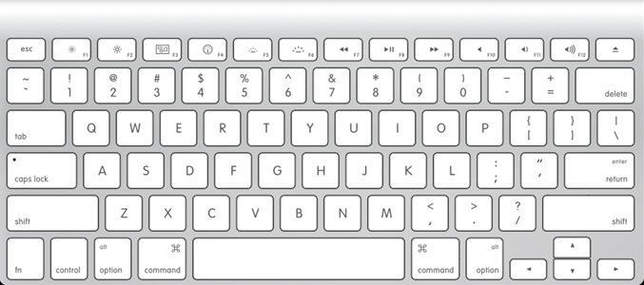
Special Keys
Tab Key allows for command auto-completion
Single Quote vs Back Tick
Arrow keys allow you to:
Move horizontally along the command to make changes without deleting and retyping everything
Move vertically through your history of previously run commands
ESC
Back tick
Tab
Single quote
Arrow keys
Ctrl

Slide 45
Ctrl-c, ESC & command line editing
If you get into a situation where you can’t seem get back to a command line prompt, try hitting the Ctrl-C combination or the Esc key – often one of those will abort whatever you are currently doing.
The Ctrl character is often represented by the ^
Use Ctrl-a to go to the beginning of the line
Use Ctrl-e to go to the end of the line

Slide 46
What is that file?
file
The “file” command tells us what type of file it might be – text, executable, PDF, jpg, gzip, tar, directory, etc.
$ file read-write.txt
$ file world.exe
$ file examples
$ file Linux_slides.pdf

Slide 47

cat and echo
Use cat to display file contents to the terminal:
$ cat bears
$ cat bears7
$ cat bears bears7
“cat” is short for concatenate. The “cat” command takes one or more files and concatenates their contents to standard output.
echo is used to output arbitrary text to the terminal:
$ echo ‘Hello World!’
$ echo without single quotes
$ echo ‘Hello World!’ > MyWorld

Slide 48
Output Redirection to Files
Redirect output (>):
$ cat bears > Teddybears
$ cat Teddybears
$ cat bears bears7 > bothbears
$ cat bothbears
$ cat bears* > allbears
$ echo ‘Hi there!’ > greeting
$ cat greeting
Append files (>>):
$ echo ‘Hi yourself!’ >> greeting
$ cat Teddybears >> greeting
$ cat greeting

Slide 49
Exercise #4: cat and echo
cat a file to view contents
$ pwd
$ cd /home/$USER/LinuxClass
$ cat lions
$ cat tigers
$ cat bears
$ cat lions tigers > animals
$ cat animals
$ cat bears >> animals
$ cat animals
Using echo
$ echo my name is Chris
$ echo “my name is $USER” > myname
$ cat myname
$ echo Hello $USER >> myname
$ cat myname

Slide 50

Symbolic links
Allows you to reference same file with different name or path – a symbolic link is a another file type.
$ ln –s <existing_file> <file_link>
$ cat Capitals
$ ln –s Capitals CapCities
$ ls –l Cap*
$ cat CapCities
Example:
$ ln –s /home/$USER/LinuxClass/examples/tmp/colors color-pairs
$ ls –la color-pairs
$ cat /home/$USER/LinuxClass/examples/tmp/colors
$ cat color-pairs

Slide 51
Creating files/directories
Using touch and mkdir
To create an empty file, use the touch command:
$ touch my_data_file
You can also create a file using an editor such as pico, nano, vi or emacs:
$ nano Music
To create a directory:
$ mkdir Mydirectory
$ mkdir 2017
$ mkdir –p 2018/Jan/stats

Slide 52
Deleting files/directories
Using rm and rmdir
To remove a file:
$ rm my_data_file
$ touch myFile
$ chmod u-rwx myFile
$ rm myFile
$ rm –f myFile
To remove a directory:
$ rmdir Mydirectory
$ rm –r 2017
rmdir only works if the directory is empty!
Dangerous:
$ rm –rf *

Slide 53
Exercise #5: Creating and deleting files
Creating a file, directory & symbolic link
$ cd /home/$USER/LinuxClass
$ echo ‘I love genomic research!’ > science
Now create a file named science_project and a directory named scienceclass (hint: use touch & mkdir)
$ ls –ld science*
$ ln –s /home/$USER/LinuxClass/examples/tmp/ice_cream ICECREAM
$ ls –la ICECREAM
$ cat ICECREAM
Deleting a file and directory
$ rm science*
$ ls –ld science*
What happened?
$ rmdir scienceclass

Slide 54
Displaying Portions of a File
“more” or “less”
$ more mascots.txt
$ less mascots.txt
- each prints out a page of a file at a time
“head” or “tail”
$ head mascots.txt
- prints out the first 10 lines by default. Can use the –n argument to change the default number of lines
$ tail –20 mascots.txt
- prints out the last 20 lines

Slide 55
Text editors
Good simple editors:
pico (pine composer)
nano (pico clone)
Advanced editors with more features:
“vim” (vi-improved)
“emacs” (Editor MACroS)

Slide 56
nano – a simple editor
$ nano filename
The essentials:
Just start typing – can use arrow keys to position, backspace or delete key to delete characters to the left
Keystrokes for basic commands at bottom of the screen
^G – help screen (^C to exit help)
^O – save the file
^W – search for a string
^X – exit nano
$ nano --help

Slide 57
Exercise #6: Editing a file using nano
$ cd /home/$USER/LinuxClass
$ nano bashrc
Using the RIGHT arrow key, position the cursor at the end of the first line,
Use the Backspace key to remove <HOMEDIRECTORY> from the first line and then type $HOME after the colon
Hit Ctrl-W (to search), type NANOPATH and hit Enter – this should place you on the last line
Hit Ctrl-E to get to the end of the line
Use the Backspace key to remove everything after the ‘=‘ sign and type ‘/bin/nano’
Use the up & the right arrow keys to get to the @ on the 2nd line
Backspace to remove <USERNAME> and type your username
Use the down arrow key to get to the 3rd line
Hit Ctrl-K to cut the 3rd line
Hit the Up arrow to get to the 1st line & Ctrl-A to get to the start of the line
Hit Ctrl-U to paste the text – the 3rd line should now be the first
Hit Ctrl-X to exit – type Yes to save the file when prompted and hit Enter when prompted for the name
$ cat bashrc

Slide 58
mv - moving files/directories
mv - move one or more files or rename a file (some Linux versions have a ‘rename’ command, but not all):
Syntax: mv source destination
$ touch football
$ touch footballgame
$ ls –l football*
$ mv footballgame footballtee
$ ls –l football*
$ mkdir sports
$ mv sports Sports
$ ls –ld *ports*
$ touch footballtee2
$ mv footballtee* Sports
$ ls –la Sports

Slide 59
cp - copying files/directories
cp - copy one or more files or directories
Syntax: cp source destination
$ cp football football2
$ cp –p football football3
$ ls –la football*
$ cp –p Sports/footballtee .
$ mkdir –p Sports/fall
$ cp –p football2 Sports/fall
$ cd Sports/fall
$ cp –p football2 ../football4
$ cd ..
$ ls –R Sports
Archival copy:
$ cp –a Sports Sports2017
$ cp –pr Sports Sports2018

Slide 60
Exercise #7: Moving/Copying Files
Move (mv)
Copy (cp)
$ cd /home/$USER/LinuxClass
$ touch Raspberry
$ mv Raspberry raspberry
$ echo blueberry > blueberry
$ ls –la *berry
Now create a directory path using mkdir with the –p option:
$ mkdir –p Berries/All/B
Use mv to move the blueberry file into Berries/All/B directory:
$ mv blueberry Berries/All/B
$ touch Berries/All/B/blackberry
$ mv Berries/All/B/blackberry .
$ mv Berries BERRIES
$ ls -Rl Berries
$ ls –Rl BERRIES
$ cp raspberry strawberry
$ cp –p raspberry cranberry
$ ls –la *berry
How do the four *berry files differ?
$ mkdir –p BERRIES/Others
$ cp –p *berry BERRIES/Others
$ mv *berry BERRIES
$ ls –la BERRIES
$ cp –pr BERRIES/Others BERRIES/More
$ ls –Rla BERRIES
$ cp BERRIES NewBerries
What did you see?
$ cp –pr BERRIES NewBerries
Archival copy:
$ cp –a BERRIES Berries-save

Slide 61
wc - what’s in that file?
“wc” (word count)
$ wc mascots.txt
345 955 7342 mascots.txt
Output shows the number of lines, words and characters in the file
Can use argument to only get one of the three values:
$ wc –l mascots.txt
$ wc –w mascots.txt
$ wc –m mascots.txt
$ wc -help

Slide 62
grep – pattern matching search of a file
“grep” – global/ regular expression/ print
$ grep cat nonsense.txt
$ grep dog nonsense.txt
$ grep –i dog nonsense.txt # case insensitive
$ grep –v dog nonsense.txt # exclude ‘dog’
$ grep –A1 cat nonsense.txt # include line after match
$ grep –B1 cat nonsense.txt # include line after match
$ grep oc nonsense.txt
$ grep –c oc nonsense.txt # count of matching lines
$ grep ^oc nonsense.txt # ^ -starts line with oc
$ grep oc$ nonsense.txt # $ - ends line with oc
grep is a powerful tool. Use it (as well as egrep...extended grep)
$ grep --help
$ man grep

Slide 63
Exercise #8: Using grep
Make sure you are in the class directory:
Using the ‘grep’ utility with the file mascots.txt, determine the following:
- find the lines that have the letters ‘cat’ (just lowercase letters) as part of the mascot name
find the lines that have the letters ‘cat’ regardless of case as part of the mascot name
find which colleges that start with the word “Saint” and redirect the output to a file named Saints – how many?
$ cd ~/LinuxClass
$ pwd

Slide 64
find – where are my darn files?
find - used to locate files based on various criteria
$ find [path_to_search] [expression/options]
$ find . –name “*.txt”
$ find /home/$USER/LinuxClass –iname “capital*”
$ find /home/$USER/LinuxClass –type f -mmin 40
$ find /home/$USER/LinuxClass –type f -mmin -40
$ find /home/$USER/LinuxClass –type f -mmin +40
$ find /home/$USER/LinuxClass –type f –mtime 1
$ find /home/$USER/LinuxClass –name “*.bak” –delete
$ find . –name “*.txt” –exec ls \-la {} \;
$ man find

Slide 65
Exercise #9: Using find
Let’s use the find utility to look for files in your home directory
Make sure you are in your class directory:
Using ‘find’, locate the file named ‘colors’
Using ‘find’, locate the files whose name contains the word ‘bear’ where the match is case insensitive (hint: -iname option)
Using ‘find’, locate the files that were modified LESS than 45 minutes ago (hint: -mmin option)
How many files did you find for each?
$ cd ~/LinuxClass
$ pwd

Slide 66
uniq – show or remove duplicate lines
uniq – show either unique or duplicate consecutive lines in a file or output. Default behavior is to merge adjacent matching lines into one, but can be used to print just the matching lines or provide a count of matching lines…most effective with the sort command
$ uniq bears # will show all unique lines
$ uniq –d bears # show only duplicate lines
$ uniq –c bears # show a count of each unique line

Slide 67

Sorting
sort command
“sort” can be used to read a file, sort the contents and output to the terminal
$ cat grades.txt
$ sort grades.txt
$ sort –r grades.txt
$ sort -k2 grades.txt
$ sort –b -k2 grades.txt
$ sort –bn -k2 grades.txt
$ sort –bnr –k2 grades.txt
$ sort –help

Slide 68

Pipes (redirect to other processes)
Much like you can write output to files, you can write or “pipe” output to other commands using pipes “|”
$ cat college1 | sort | uniq
$ cat college2 | sort | uniq
$ cat college1 college2 | sort | uniq -c
Write to a file at the end:
$ cat college1 college2 | sort | uniq |grep ^B > Colleges

Slide 69
Exercise #10: sort, pipes and redirection
cd /home/$USER/LinuxClass
Look at the contents of two files, grocery1 and grocery2 (use cat command)
Combine the two files using the cat command and then use the sort and uniq commands to get a list of sorted, unique items for the grocery list
Now redirect the output to a file named grocery3
Use the wc command to determine how many unique items are on the list (in the grocery3 file).
Use grep and wc to determine how many items in the grocery3 list start with the letter ‘c’

Slide 70
Exercise #10 continued
$ cat grocery1
$ cat grocery2
$ cat grocery1 grocery2 | sort | uniq
$ cat grocery1 grocery2 | sort | uniq | wc –l
You should have 32 items
$cat grocery1 grocery2 | sort | uniq > grocery3
$ grep ^c grocery3
7 items start with the letter c

Slide 71
Other useful commands
history – displays a history of commands which allows for an easy way of running a command again without having to type it out again
alias – list aliases or create a new one for another cmd
Example:
$ alias hist=“history 20”
cut – print out selected fields
Example:
$ cat famousdogs | cut –f1,4 –d:
diff – find the differences between two files:
$ diff numbers1 numbers2

Slide 72
date & cal
date – prints the current date and time
$ date
Wed Sep 12 15:08:17 EDT 2018
$ date +“%D %T”
09/12/18 15:08:18
cal – print the calendar for the current month or entire year
$ cal 2018

Slide 73
Input, Output and Error
Commands can have an input and output
STDIN or ‘standard input’ is input from the keyboard though we can have redirected input from a file
STDOUT or ‘standard output’ is output going to the screen. We’ve already seen where we can ‘redirect’ the output of a command to a file or pipe it as the input to another command
Commands may also produce errors such as ‘Permission denied’
STDERR or ‘standard error’ is error output that goes to the screen by default

Slide 74
Input, Output and Error (cont)
STDIN, STDOUT and STDERR have handles or numbers associated with each:
Handle
STDIN 0 Standard input
STDOUT 1 Standard output
STDERR 2 Standard error
Let’s change permissions on dogs2 to be unreadable:
$ cd $HOME/LinuxClass
$ chmod ugo-r dogs2
Can redirect the STDERR to a file:
$ grep dog dogs* 2> errors
$ grep dog dogs* 2> /dev/null
Can redirect BOTH the STDOUT and STDERR to a same file:
$ grep dog dogs* > out_plus_errs 2>&1
or to different files:
$ grep dog dogs* > OUTPUT 2> ERRORS

Slide 75
Putting it all together
Program first, then arguments, then any file I/O
Most programs will read from standard input (stdin) if no file is specified in arguments
Read in from a file with input redirection, do some stuff and output to another file:
$ sort < Colleges.txt | grep -i ^C > C-colleges

Slide 76
awk – text manipulation
In awk, lines are broken down into fields that are represented by variables $1, $2, $3, etc
‘print $1’ will print the first field
Let’s look at an example:
$ cat hare_tortoise
The hare beat the tortoise handily.
We can change the ordering of words using awk:
$ cat hare_tortoise | awk ‘{print $1,$5,$3,$4,$2,$6}’
The tortoise beat the hare handily.
You do NOT have to use all of the fields – can pick and choose as needed

Slide 77
sed – stream editor for pattern matching and modification
In sed, one can do text pattern matching and modification
$ cat hare_tortoise
The hare beat my tortoise handily.
If we want to change the word ‘beat’ with the word ‘defeated’:
$ cat hare_tortoise | sed ‘s/beat/defeated/g’
The hare defeated my tortoise handily.
The trailing ‘/g’ at the end of that command indicates that the change is to be done globally…without it, only the first occurrence of the word in the file will be changed.
We can use both awk & sed on the same command line:
$ cat hare_tortoise | awk ‘{print $1,$5,$3,$4,$2,$6}’ |
sed ‘s/beat/defeated/g’
The tortoise defeated my hare handily.

Slide 78
tr – allows character substitution or translation
With tr, characters can used to translated – perhaps to change the case of letters:
$ echo ‘Let’s Go Caps!!!’ | tr “a-z” “A-Z”
LET’S GO CAPS!!!
Or to replace a new line character (\n) with a space or comma:
$ cat numbers2 | tr “\n” “ ”
1 2 3 4 5 6 7 8
$ cat numbers2 | tr “\n” “,”
1,2,3,4,5,6,7,8,

Slide 79
More Linux Command Basics…Quotes
Linux treats single, double and back quotes in commands differently
Contents of a set of single quotes are treated as a string:
$ echo ‘$USER’
$USER
Contents of a set of double quotes will have any included variables replaced:
$ echo “The home directory of $USER is $HOME”
The home directory of username is /home/username
Contents of a set of back quotes or back ticks (on the upper left of the keyboard) are treated as a command and the output can be assigned to a variable:
$ NOW=`date`; echo $NOW
Mon Jul 30 15:08:56 EDT 2018

Slide 80
Your PATH
Execution path
In BASH, execution of a program happens when you enter the program name. Your PATH variable keeps you from having to enter the full path to the program
Modifying your PATH
$ echo $PATH
$ PATH=$PATH:/data/$USER
$ echo $PATH
To path changes permanent, need to modify the .bashrc file in your home directory.
$ echo $PATH
$ which date
$ which whoami
$ which perl

Slide 81
Shell Variables
Variable assignment
From a file
Arbitrary assignment
$ MYWORLD=“Hello World”
$ echo $MYWORLD
$ MY_PI=3.14
$ echo $MY_PI
With program output
$ RIGHTNOW=`date`
$ echo $RIGHTNOW
Mon Jul 30 15:08:56 EDT 2018
$ FILE=`cat nonsense.txt`
$ echo $FILE
$ echo $FILE | tr “ “ “\n” \
|sort | uniq

Slide 82
Shell Variables
Show all currently assigned variables
Useful predefined and important variables
$ printenv
HOSTNAME=biowulf.nih.gov
TERM=xterm
SHELL=/bin/bash
HISTSIZE=500
SSH_CLIENT=165.112.93.227 49886 22
OLDPWD=/home/mark
HISTFILESIZE=500
USER=mark
…
$HOSTNAME System hostname
$USER Your Username
$SHELL Your shell
$HOME Home directory
$PWD Current directory
$PATH Command paths

Slide 83
Loops
“For” loops allow for iteration based on flow control criteria
Perform math using the seq command:
$ for n in 1 2 3 4 5 6 7
> do
> echo The value of n is $n
> done
$ for n in {1..7}
> do
> echo The value of n is $n
> done
$ for n in `cat Capitals`
> do
> echo $n|tr “a-z” “A-Z”
> done
$ seq 1 10
$ t=0
$ for n in `seq 1 10`; do
> t=`expr $t + $n`
> echo $t
> done
$ echo $t
55
$ t=1
$ for n in `seq 1 10`; do
> t=`expr $t \* $n`
> done

Slide 84
Loops, part 2
Let’s combine contents of many named files into one
$ cd /home/$USER/LinuxClass/loops
$ cat nih1
.
.
$ cat nih9
We can combine the contents of the 9 nih named files into one using a loop:
$ for i in `seq 1 9`
> do cat nih$i >> NIH-ALL
> done
$ cat NIH-ALL

Slide 85
Logic tests
Equality: if, then, else, fi
Existence
$ TRUE=“good”
$ if [ “$TRUE” = “good” ]
> then
> echo “it’s true”
> fi
$ if [ “$TRUE” = “no good” ]
> then
> echo “true statement”
> else
> echo “false statement”
> fi
$ if [ -e $HOME/.bashrc ]
> then
> echo true
> fi
$ if [ -d $HOME/LinuxClass ]
> then
> echo true
> fi

Slide 86
File Transfer
SCP, SFTP and clients
Clients
SCP and SFTP are file transfer protocols that run over SSH, the same protocol that you used to log in
They are very secure and encrypt both the log-in and content of any transfer
Linux/MacOS:
“scp” secure copy
“sftp” secure FTP
“fuze-ssh” (Linux only)
Windows:
WinSCP
Filezilla
Swish

Slide 87
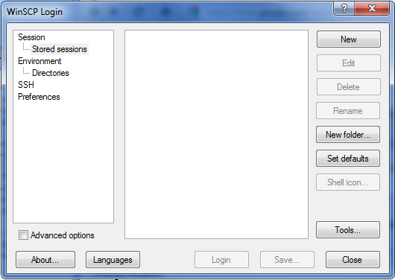
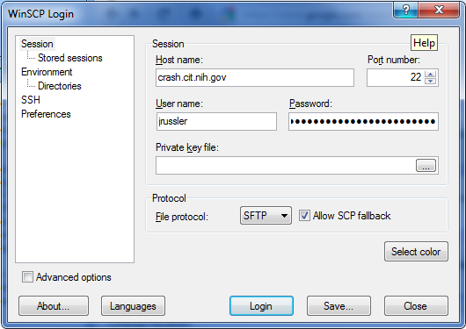
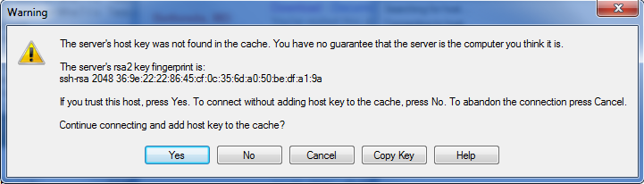
WinSCP
Start WinSCP
Click “New”
Enter the host name (i.e.: crash.cit.nih.gov)
Fill in user name
Leave password blank
Click Login
If this is the first time you’ve connected to this host, you’ll have to accept the host’s key

Slide 88
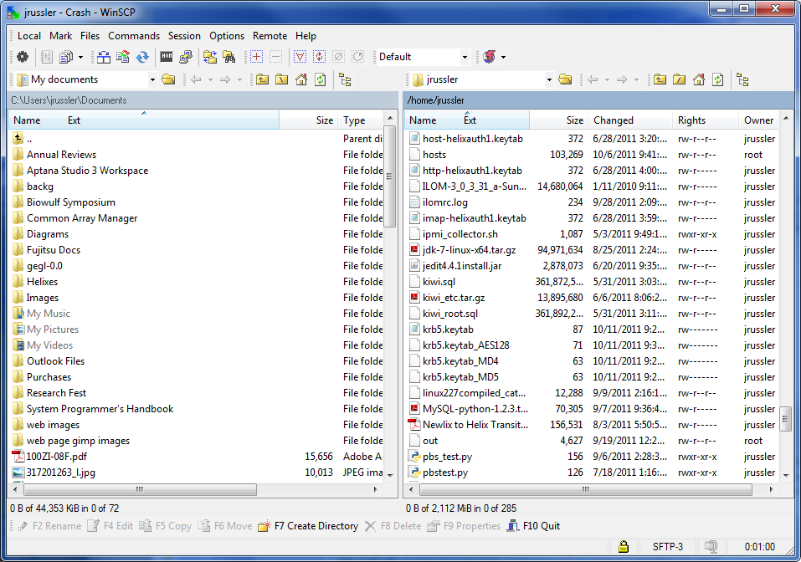
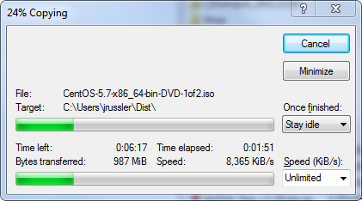
WinSCP Interface
Left window is your local workstation, right window is the remote host
Drag and drop files
Navigate like a traditional explorer interface

Slide 89
Using OpenSSH (Unix/Linux/MacOS)
SCP files via command line:
Using SFTP
Transfer a file:
$ scp helix.nih.gov:/tmp/file ~
Recursive transfer (whole directory)
$ scp –r helix.nih.gov:/tmp/dir ~
Preserve time stamps of the file being transferred:
$ scp –p helix.nih.gov:/tmp/file ~
From local host to remote.
$ scp ~/file helix.nih.gov:/tmp/
As usual
$ scp --help
$ man scp
$ sftp helix.nih.gov
sftp> cd /tmp
sftp> get file
Fetching /tmp/file to file
/tmp/file 100% 2048KB 2.0MB/s 00:00
sftp> put file newfile
Uploading file to /tmp/file
file 100% 2048KB 2.0MB/s 00:00
sftp> exit
$ man sftp

Slide 90
File Transfer via Helixdrive
Network drive (Windows)
Network Drive (MacOS)
Helixdrive is available to users with NIH HPC (Helix/Biowulf) accounts:
Open “Computer” from the start menu
Click “Map Network Drive”
Folder: helixdrive.nih.gov/username
Click Finish
If prompted, enter NIH username and password
Menu Bar -> Go -> Connect to Server
Server Address: smb://helixdrive.nih.gov/username
Click “Connect”
Check “Registered User”
If prompted, enter NIH username and password

Slide 91
Globus
Globus is a service that allows one to transfer large amounts of data in & out of systems. It will manage the file transfers, monitor performance, retry failures, recover from faults automatically when possible, and report the status of your data transfer.
Requires an endpoint at source & destination. You can install Globus Connect on your local Windows, Mac or Linux system to create personal endpoint. NIH users can authenticate using their NIH username & password.
The HPC (Biowulf/Helix) endpoint is nihhpc#globus. More information regarding Globus can be found at:
https://hpc.nih.gov/storage/globus.html

Slide 92
Exercise #11: Using scp
Type ‘exit’ to log off from Helix and get back to your local system:
$ exit
Use scp to copy the file read-write.txt from Helix to your local system – NOTE the trailing space & period in each command!
$ scp username@helix.nih.gov:/data/classes/linux/read-write.txt .
Now copy a whole directory:
$ scp -pr username@helix.nih.gov:/data/classes/linux/examples .
Reconnect to helix via ssh once the file transfer has been completed

Slide 93
Processes
Show processes
Show your processes:
$ ps
$ ps –f
sleep is a delay or pause for specified number of seconds
$ sleep 5
$ sleep 25 &
$ ps -f
$ ps –f --forest
Show all processes:
$ ps –e
$ ps –ef --forest
$ man ps

Slide 94
More on Processes
Background and Foreground processes
A command/job can be run in the background by adding ‘&’ to end of the command:
$ sleep 50 &
[1]+ Done sleep 50
ctrl-z suspends a running job/process
bg allows you to resume a suspended job in the background and returns you to the command prompt
fg allows you to resume a suspended job in the foreground until it completes
ctrl-c interrupts or kills the currently running process
Warning: Backgrounded processes will die when you log out of your session unless you use something like nohup or screen.

Slide 95
More on Processes
Detach and Reattach processes
Killing a process
Ctrl-z suspends an active job
$ sleep 300
[ctrl–z] (process is suspended)
$ bg
$ ps –f
$ fg
$ sleep 300
[ctrl-Z]
$ bg
$ ps
PID TTY TIME CMD
6686 pts/0 00:00:03 bash
8298 pts/0 00:00:00 sleep
8299 pts/0 00:00:00 ps
(find the PID of the process you want to kill)
$ kill 8298

Slide 96
Processes: kill them
“kill” only requests that the program exit. Use a signal 9 to force it to exit
The kill command is slightly misnamed, what it actually does is send a signal to a process
Most signals are interpreted by the application being signaled and thus behavior is consistent only by convention
Using signal 9 is dangerous if used indiscriminately
$ sleep 300
[ctrl-Z]
$ ps
PID TTY TIME CMD
6686 pts/0 00:00:03 bash
8298 pts/0 00:00:00 sleep
8299 pts/0 00:00:00 ps
(find the PID of the process you want to kill)
$ kill -9 8298

Slide 97
Exercise #12: Using ‘kill’ on a process
First start a ‘sleep’ process that will run in the background for 300 seconds:
$ sleep 300
Type ‘Ctrl-z’ (the Ctrl and z keys together) to suspend the ‘sleep’ process
Type ‘bg’ to unsuspend the ‘sleep’ process and have it run in the background.
Check that the process is running by using the ‘ps’ command and note the pid, process identification number
Using the ‘kill’ command with the pid of the sleep process from the previous step, terminate the sleep process
How can you check that the sleep process is gone?

Slide 98
uptime
uptime shows a summary of the system status
$ uptime
14:39:46 up 14 days, 7:00, 305 users, load average: 39.18, 40.68, 38.68
Numbers shown from left to right:
- Current time
- Amount of the time the system has been up
- Number of users currently logged on
- The average system load for the past 1, 5 and 15 minutes
- The load is the usage of the system’s CPUs – a load of 1 corresponds to a full load of 1CPU

Slide 99
Who is doing what…using top
By default, top will produce continuous output about running processes
$ top
top - 16:19:54 up 28 days, 9:07, 255 users, load average: 32.18, 32.79, 33.22
Tasks: 4749 total, 8 running, 4733 sleeping, 7 stopped, 1 zombie
Cpu(s): 9.6%us, 5.8%sy, 6.0%ni, 78.2%id, 0.2%wa, 0.0%hi, 0.2%si, 0.0%st
Mem: 1058656848k total, 955041356k used, 103615492k free, 79064k buffers
Swap: 67108856k total, 547376k used, 66561480k free, 89619996k cached
PID USER PR NI VIRT RES SHR S %CPU %MEM TIME+ COMMAND
120202 johanesb 39 19 235m 180m 1432 R 96.4 0.0 170:21.86 merlin
252158 liqingli 39 19 58496 26m 756 S 95.0 0.0 17141:15 moe
170176 bozser 33 13 407m 117m 2588 S 60.1 0.0 62:30.33 ascp
218983 jrussler 20 0 18532 4704 872 R 22.3 0.0 0:00.38 top
127988 elliottm 39 19 223m 3544 1064 S 16.8 0.0 782:02.42 sshd
198816 wenxiao 20 0 4280 792 416 D 14.0 0.0 24:50.19 gzip
Hit ‘q’ to quit out of top

Slide 100
Looking at file system (disk) Space
To see local file system space:
$ df –l
Filesystem 1K-blocks Used Available Use% Mounted on
/dev/mapper/vg_helix-root
51403396 8502228 40289968 18% /
tmpfs 529355640 2216 529353424 1% /dev/shm
/dev/sda2 495844 180879 289365 39% /boot
/dev/sda1 204580 33228 171352 17% /boot/efi
/dev/mapper/vg_helix-tmp
51606140 973788 48010912 2% /tmp
/dev/mapper/vg_helix-var
32253856 19349996 11265460 64% /var
To see numbers in human readable format:
$ df –lh
Filesystem Size Used Avail Use% Mounted on
/dev/mapper/vg_helix-lv_root
50G 8.9G 38G 19% /
tmpfs 505G 5.6M 505G 1% /dev/shm
/dev/sda2 485M 142M 318M 31% /boot
/dev/sda1 200M 256K 200M 1% /boot/efi
/dev/mapper/vg_helix-lv_tmp
50G 613M 47G 2% /tmp
All filesystems, including network file systems:
$ df –h

Slide 101
Directory size
Estimate file space use (du)
$ cd /home/$USER
Estimate a file size:
$ du LinuxClass/Linux_slides.pdf
Summary:
$ du -s LinuxClass
Summary in human-readable format:
$ du -sh LinuxClass
Default behavior:
$ du

Slide 102
Checking Quotas on Helix/Biowulf
“checkquota”
The checkquota command will query all network storage devices to find the applicable quota(s) for your user
This command is specific to Helix and Biowulf and is not available to Linux in general since it relies on information that is site-specific to this infrastructure.
$ checkquota
Mount Used Quota Percent Files
/data: 94.2 GB 200.0 GB 47.12% 70424
/home: 5.2 GB 16.0 GB 32.50% 133607

Slide 103
tar & gzip
The tar command allow users to compress and archive files – does not remove the original files by default
Syntax for tar to create an archive:
$ tar –czvf <output file> <files to be archived>
where c is to create
z is to compress using gzip
v is verbose output (lists files as they are tar’d)
f indicates that the next argument is the output filename
Syntax to extract files from an archive:
$ tar –xzvf <filename>
Syntax to list the files in a tar file:
$ tar –tzvf tarfile.tar.gz
The gzip command is similar, but the original file is removed unless you specify to keep it with the ‘-c’ option.
Example:
$ gzip files.gz

Slide 104
Cron
Cron: run a job whenever you want
crontab -l
crontab –e
--
15 3 * * * ~/script.sh >> ~/output 2> ~/error.log—
Runs “script.sh” at 3:15AM every day of every week of every month of every year.
* * * * *
First number is the minute at which to run (0-59)
Second is the hour (0-23)
Third is the day of the month (1-31)
Fourth is the month (1-12)
Fifth is the day of the week (0-6), 0 is Sunday

Slide 105
Review
History – Linux Torvalds, 1991
Why Linux? Performance, functionality and portability
Bash shell & shell variables
Files and directories – permissions & ownership
Linux file system
Paths to files/directories
Basic Linux commands to create & access files & directories
nano editor
sort, grep & find
pipe & file redirection
transferring data to & from a Linux system
processes
cron

Slide 106
Resources
Linux Documentation Project: http://www.tldp.org
Introduction to Linux - A Hands on Guide:
http://www.tldp.org/LDP/intro-linux/html/index.html
Bash Guide for Beginners:
https://www.tldp.org/LDP/Bash-Beginners-Guide/html/
Linux Tutorial at the Texas Advanced Computing Center (TACC):
https://portal.tacc.utexas.edu/-/linux-unix-basics-for-hpc
NIH HPC Web Site: https://hpc.nih.gov/training

