Slide 1
NIH HPC Object storage system overview
Tim Miller
NIH HPC Systems Staff
btmiller@helix.nih.gov
https://hpc.nih.gov
February 28. 2017

Slide 2
Outline
Overview of the object storage
A first practical example
When would you want to use object storage?
How do you get access to the object storage?
Using the NIH HPC object storage
HPC staff developed tools
Rclone
s3cmd
Programming your own tools

Slide 3
Introductions and Administrivia
Who am I?
Who are you?
How much data are you storing on the HPC systems?
What do you know about object storage?
What makes you interested in object storage?
How can I and the rest of our staff help you?
Can you access your HPC account?
Do you have an object storage allocation already?

Slide 4
Outline
Overview of the object storage
A first practical example
When would you want to use object storage?
How do you get access to the object storage?
Using the NIH HPC object storage
HPC staff developed tools
Rclone
s3cmd
Programming your own tools

Slide 5
Basics of object storage
“Web Scale” storage
Highly reliable (dispersed over multiple sites)
Easy to expand (just add more disks)
Accessed via simple list, put, get, delete semantics (examples forthcoming)
Different from file based storage systems
Objects are accessed by NAME, not PATH
Completely flat name space
No concept of directories, but “/” is a valid character in object names
Data and metadata are stored together with the object (sometimes true in file storage systems as well)

Slide 6
The NIH HPC object storage systems
https://hpc.nih.gov/storage/object.html
Dedicated for use by NIH HPC system (helix, biowulf) users
Accessible from Helix, Biowulf, and compute nodes
No Globus or Helixdrive (more on this later)

Slide 7
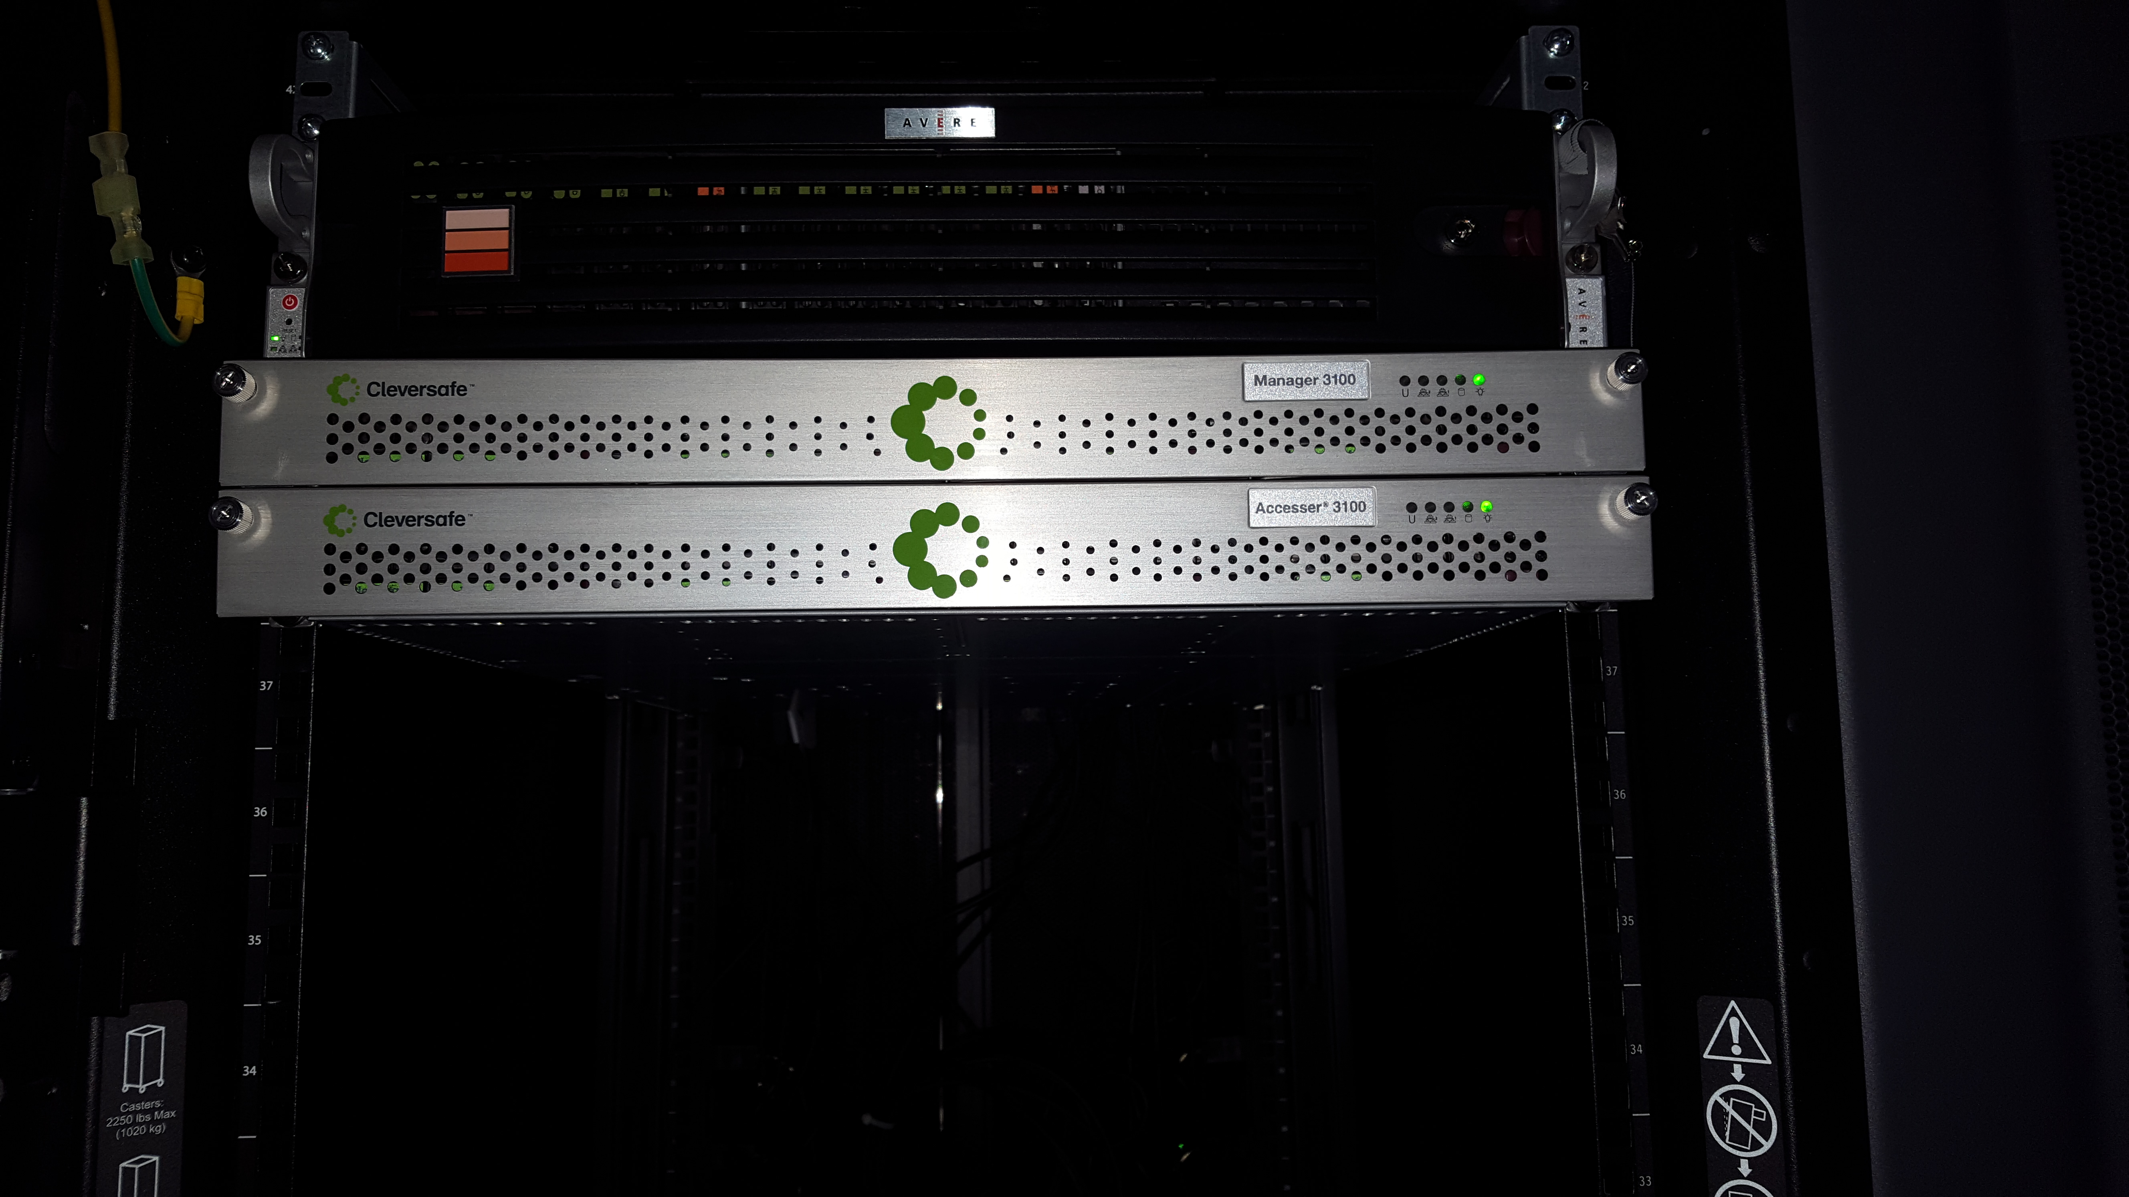
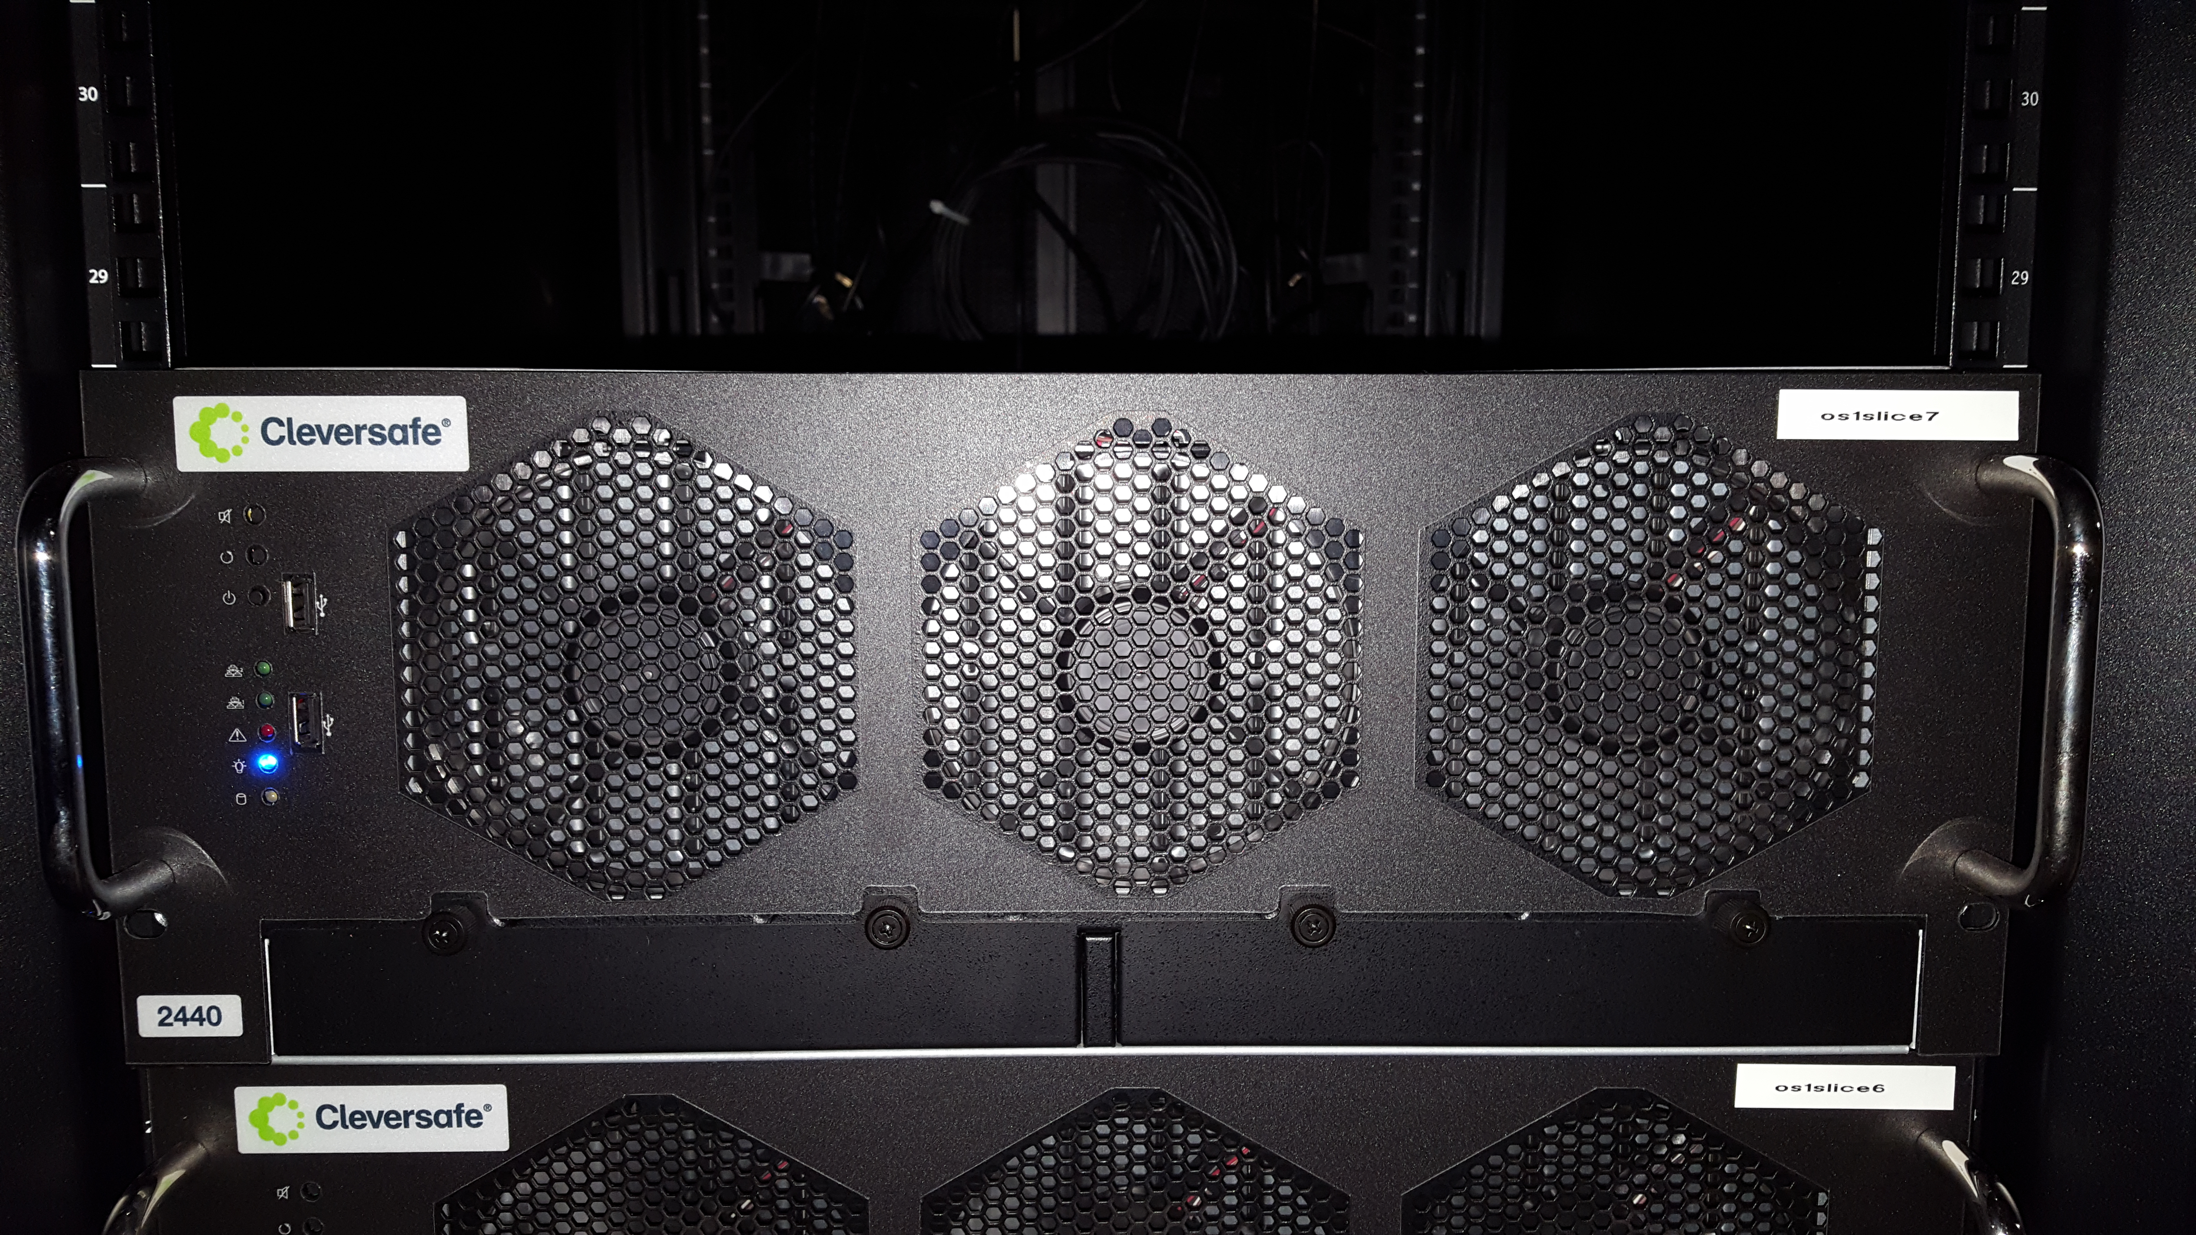
Components of the system
Manager
Manager
Staff interacts with it
Used for provisioning, monitoring, etc.
Accessor
Primary point of user interaction
Storage server
Actually holds data
No direct user interaction
Accessor
Slicestor

Slide 8
Components of the system
Manager
Manager
You interact with it indirectly
Accessor
Primary point of user interaction
Storage server
Actually holds data
No direct user interaction
You don’t need to know anything about the physical hardware.
However, if you want to write your own custom access routines, you need the accessors’ addresses.
Accessor
Disk
storage

Slide 9
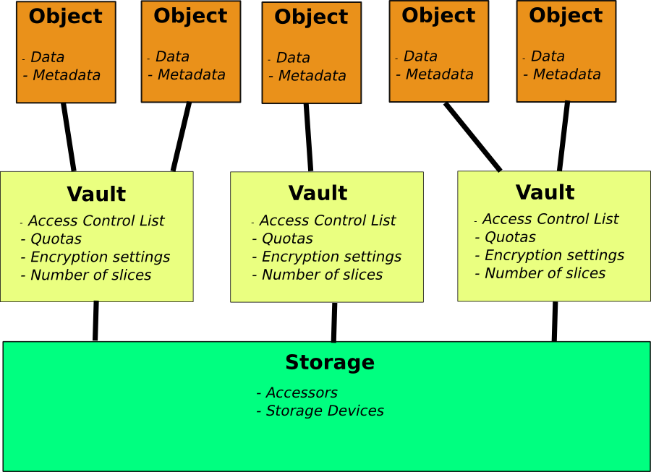
Logical View

Slide 10
Logical view components (1)
Each user has access to one or more VAULTS
These are like buckets, for those familiar with Amazon S3, except they are created by system administrators.
The vaults are containers for objects
Objects contain both data and metadata (we’ll see examples)
Physically, objects are divided up and different parts are sent to multiple different storage servers
The system is designed to be able to lose a certain number of storage servers and still be able to reconstruct objects.

Slide 11
Logical view components (2)
I/O operations are performed via accessors
Use S3 operations layered on top of the HTTP protocol
Three accessors: os1access1, os2access1, os3access1
A RESTful API (REpresentational State Transfer) – see next bullet point!
When configuring some programs to access the object store, you must specify which accessor to use
We’ll see examples later
Take a REST!
A RESTful API handles transactions
PUT, GET, DELETE
No multiple-part requests!
Pre-written programs (and your own)

Slide 12
Outline
Overview of the object storage
A first practical example
When would you want to use object storage?
How do you get access to the object storage?
Using the NIH HPC object storage
HPC staff developed tools
Rclone
s3cmd
Programming your own tools

Slide 13
Our first example: just showing off
Key commands
obj_df
obj_ls
obj_put
obj_get
Key take-aways
Object storage is not accessed like disk storage
We have to use special tools (or write our own)
Programs need to be directly aware of the object store to use it, or files must be staged to an intermediate location.
Notes:
Note – I will be doing a demo in the terminal here showing basic tool usage!

Slide 14
Outline
Overview of the object storage
A first practical example
When would you want to use object storage?
How do you get access to the object storage?
Using the NIH HPC object storage
HPC staff developed tools
Rclone
s3cmd
Programming your own tools

Slide 15
Use-cases for object storage
Read-intensive workloads
Object storage is much more efficient at reading than writing.
An entire object has to be re-written for each change
Computationally expensive to process and disperse the data
Lots of over-writing
Static data
Related to the above
Data that doesn’t change often, but still used
E.g. reference genomics files

Slide 16
When not to use object storage
Content of data changes frequently (database updates)
Data will not need to be repeatedly read (use scratch or lscratch)
Only need to read part of each unit of data (object store will read the whole thing usually)
Reads are performance critical

Slide 17
Some important limits of the HPC object store
Accessible only within the HPC systems’ network
This will change – probably within the next 3-6 months
No Globus access (may change)
No Helixdrive access (will not change, but once open to NIH you can use other tools to provide a similar interface)
No “self-service” vault/bucket creation
Vaults are created by the HPC staff
Users may be added/removed from a vault by the owner by e-mailing staff

Slide 18
And finally…
ALL NIH HPC policies that apply to other HPC storage systems apply to the object store
No personally-identifiable information (PII)
No personal health information (PHI)
No archiving – objects must be actively computed against!

Slide 19
Outline
Overview of the object storage
A first practical example
When would you want to use object storage?
How do you get access to the object storage?
Using the NIH HPC object storage
HPC staff developed tools
Rclone
s3cmd
Programming your own tools

Slide 20
Requesting object storage
https://hpc.nih.gov/nih/object_request.html
Accessible from within the NIH network (and VPN).
If off-campus, e-mail staff@hpc.nih.gov.

Slide 21
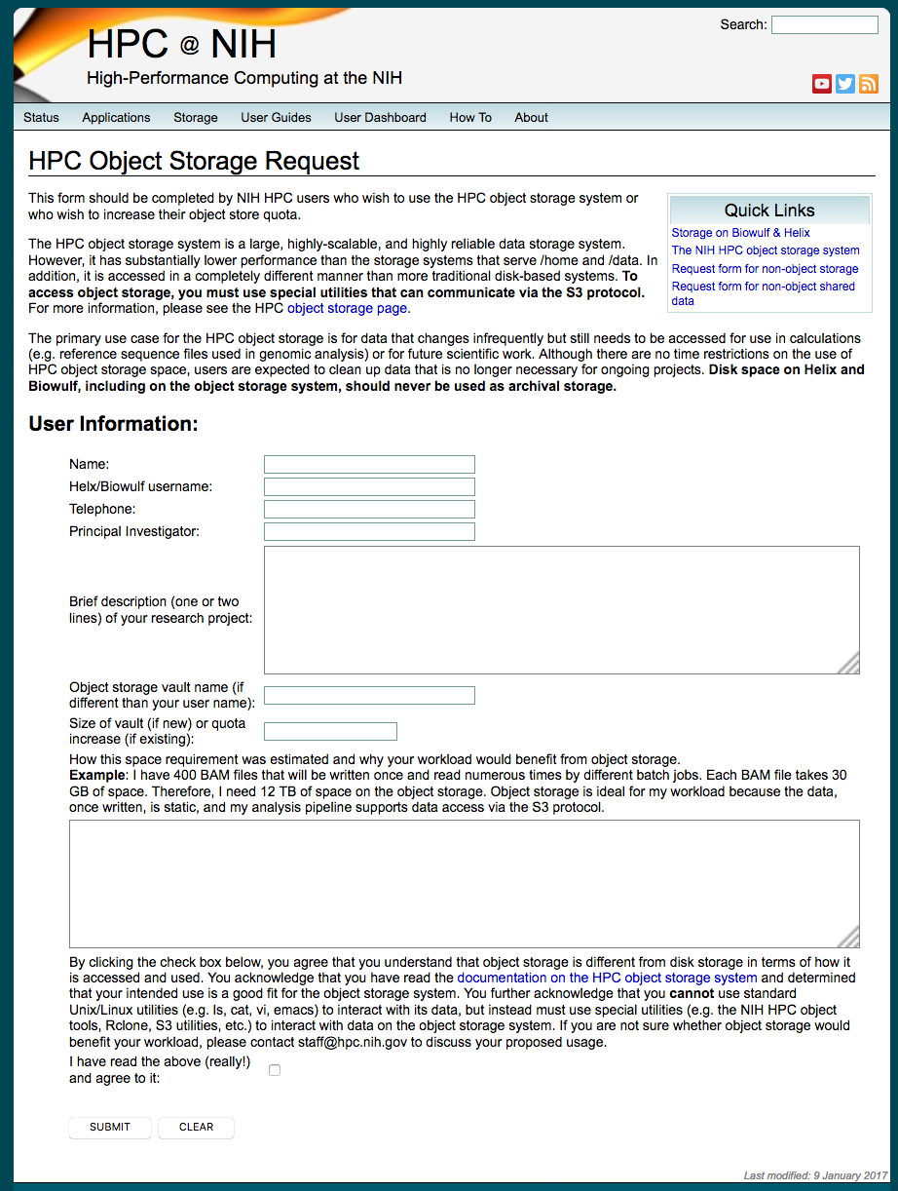

Slide 22
This part of the form is the same as the disk (or shared data) request form.

Slide 23
Unlike your data directory, you can choose any name for your vault (within reason). If you leave this blank, the vault name will be the same as your user name.
You also have to tell us how big you would like your vault. We generally will not give out more than 20 TB until you show that you can make effective use of it.

Slide 24
For your justification, be sure to specify why you are requesting object storage rather than disk storage. Letting us know whether you plan to use your own programs or HPC developed or installed tools is also helpful.

Slide 25
Remember to check the box at the bottom indicating that you understand what object storage is and the policies associated with its use.

Slide 26
Once you have submitted the form
You’ll get an e-mail confirmation
The HPC staff will contact you if there are any questions about your request
Your storage will be set up. You’ll be given a set of access keys that you can use to access your space.

Slide 27
More policies to be aware of
NO back-ups or snapshots
If you delete something from the object store, it’s gone (unless you have another copy somewhere).
Likewise, if you overwrite an object, the original copy is unrecoverable.
Reduce metadata operations
As much as possible, avoid listing vault contents – it’s slow!
Use a regular scheme for naming objects or keep an off-line index
No PII, PHI, or Archiving

Slide 28
Hands-on: setting up access
I will distribute access keys to individuals/teams
Note: the vaults used in this class are TEMPORARY and will be deleted a day or so after the class ends.
In other words, don’t store anything you actually want to keep (only) here.
Create a file /home/$USER/.boto
Replace $USER with your user name
Make sure the file is only readable by you
Put the following contents in the file:

Slide 29
Hands-on: setting up access
Check that you can “see” your vault when you do obj_df.
Note – obj_df will not work with temporary student vaults.
How much space do you have on the object store?
Tip: obj_df reports value in bytes, which is not very easy to read. Use “obj_df -h” to get human-readable values.
Run “obj_ls” to see the contents of your vault
This will work with temporary student vaults
If your vault name is not the same as your username, use “-v <vaultname>” to specify which vault.
Is there anything in your vault?

Slide 30
Outline
Overview of the object storage
A first practical example
When would you want to use object storage?
How do you get access to the object storage?
Using the NIH HPC object storage
HPC staff developed tools
Rclone
s3cmd
Programming your own tools

Slide 31
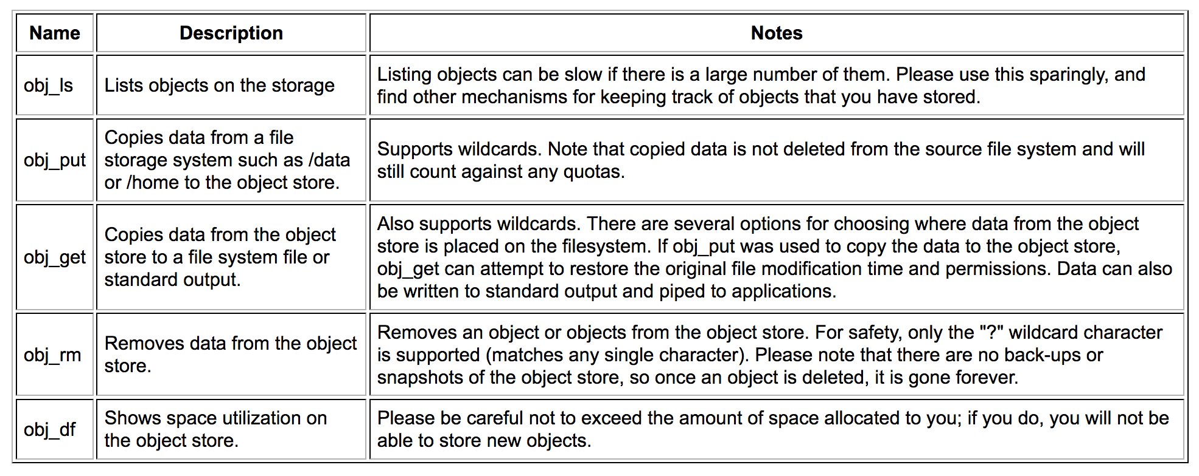
Overview of staff-developed tools

Slide 32
Using obj_df
Shows you how much space you have on vaults you have write access to.
Can get the same information (in a slightly different format) via checkquota

Slide 33
Using obj_ls
Lists objects in a vault
Owner ID is specific to the object store (i.e. not a Linux UID)

Slide 34
A prettier view
-h: sizes are human readable
-m: only print out files that match a given pattern

Slide 35
Listing different vaults
Some users have access to multiple vaults (see obj_df)
Use -v flag on all obj tools to specify a vault
The default vault is the same as your username (may not exist)

Slide 36
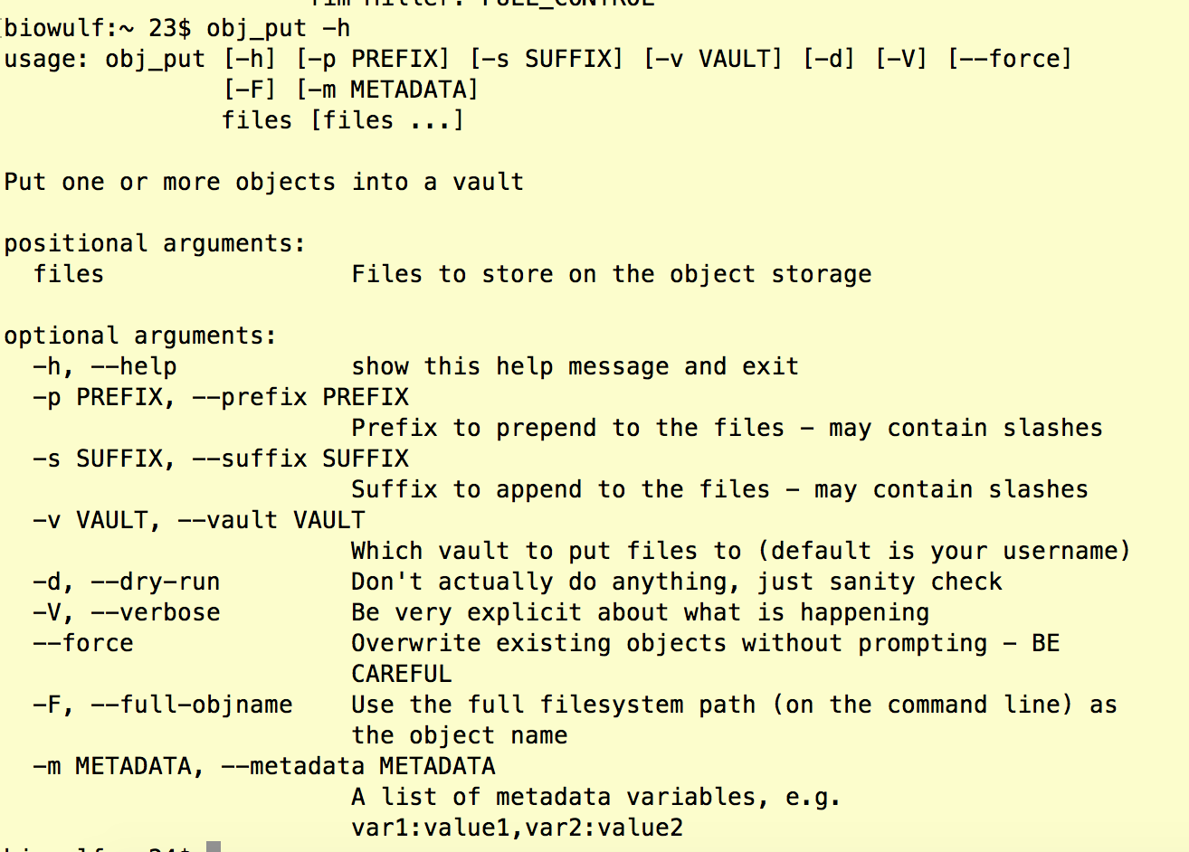
Putting data onto the object store
Use obj_put
Numerous options – we’ll go through some of the more important

Slide 37
Putting data onto the object store
Use prefix (-p, --prefix) to make a “directory”, e.g. ”-p new_results/”
Trailing slash is important!
Use –F (--full-objname) to have the object name be the full path on the system.

Slide 38
An example

Slide 39
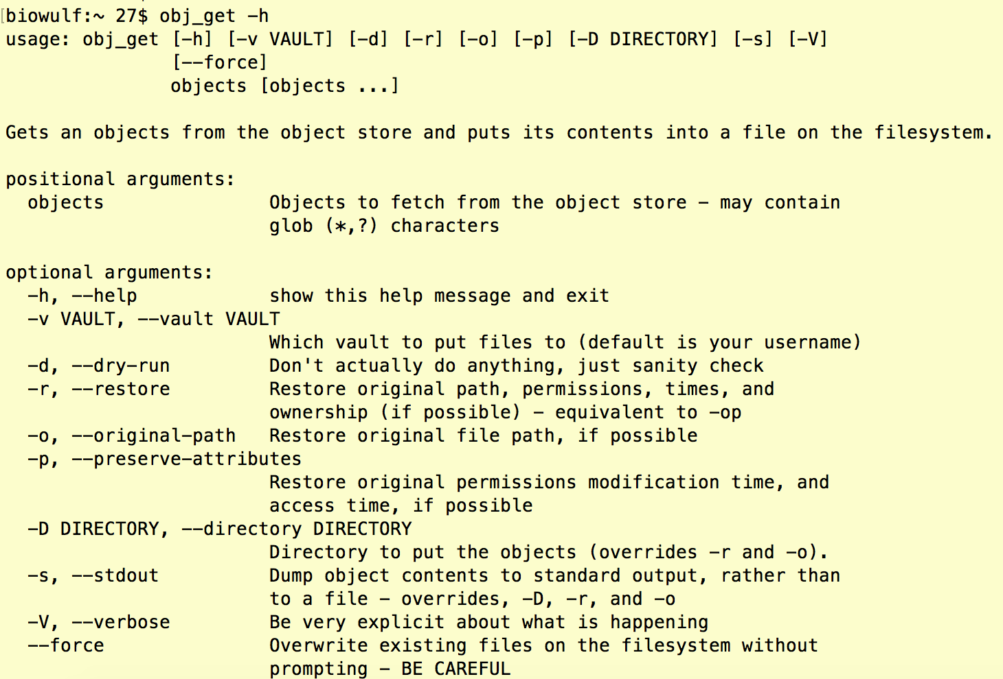
Getting the data back with obj_get
Like obj_put, has a lot of options
Several are important!

Slide 40
Getting the data back with obj_get
Note use of -r, -o, and -p
Rely on having metadata associated w/ the object.
Probably will not work unless placed with obj_put.
Overriden by -D
--stdout is a very useful option
Stream object data to programs

Slide 41
Streaming to stdout example
Useful for piping into commands
Cannot ingest data from a pipe
It would probably be way too slow

Slide 42
Practice time!
Copy /data/classes/objectstore to your data directory
Copy the file lamb.txt to your object store vault
Verify that the copy is there. How did you do this?
Read the data back from the object store two different ways
Stream it to standard output
Read it back to a file in a new directory called lamb2
Upload the data fruits.txt in the “some_files” directory to your object store vault
Sort the fruits.txt data alphabetically (use the Linux sort command), output the results to your data directory, and then copy the sorted file to the object store.

Slide 43
Permissions and obj_chmod
By default, objects in vault are only visible to users who have access rights to that vault.
Vaults are treated similarly to shared data directory: requestor becomes the vault owner who can add or delete users.
Users can have read-only or read-write permissions
A user who has write permission on a vault can make an object publicly visible.
Use obj_chmod to set “private” or “public-read” permissions
Available via HTTP “wget -O output http://os3access1/vault/object”
Not accessible beyond the NIH HPC systems, but this will change

Slide 44
Using the obj command
obj is a single command that gives access to all object commands
See “obj help” for usage
E.g. “obj put” calls “obj_put”
One additional function – “obj url”, prints a URL of a publicly-available object
Use in conjunction with obj_chmod
URL is only reachable within the HPC systems!

Slide 45
Overview of rclone
Another tool for copying/synchronizing data between file storage and object storage
Specializes in synchronizing entire directories to/from object storage
Like rsync, but for the object store
Not the most convenient tool for single files, but more convenient than obj_* for lots of data
In addition to the HPC object store, can talk to other systems (S3, DreamHost, etc.).
Remember to use --no-check-certificate when using with the HPC object store (might want an alias)
Web site https://hpc.nih.gov/apps/rclone.html

Slide 46
Configuring rclone
Load the module
module load rclone
Configure:
rclone config
Remember what you name your object store (or check ~/.rclone.cfg)
For HPC object store
Choose Amazon S3 storage
Enter object key and secret key
For region – choose S3 clone that understands v2 signatures (12)
Enter os3access1 as the endpoint (can also use os1access1 or os2access1)
Leave other items as default
See example at https://hpc.nih.gov/apps/rclone.html!

Slide 47
Using rclone
Important argument “--no-check-certificate”
Needed for NIH HPC object store, since it uses self-signed SSL certificate
Vaults are denoted <storage-system-name>:<vault-name>
E.g. nihhpc-obj:btmiller
The storage system name is what you defined it to be when configuring rclone!
“rclone ls” – list a directory
E.g. “rclone ls nihhpc-obj:btmiller”
“rclone lsd” will list only directories
“rclone copy” – copy from source to destination
“rclone move” – move from source to destination
“rclone (purge|rmdir)” – removes paths
Sources and destinations can be
Object store (HPC or other)
Filesystem paths

Slide 48
Configuring s3cmd
Another general purpose tool for accessing S3 storage
Has similar functionality to the HPC developed tools
To configure, just run: s3cmd --configure
Provide your access key and secret keys
Up to you if you want an encryption password (but don’t forget it!)
No need to use HTTPS on the HPC network (but you can for extra protection) – if you use it, you will need the --no-check-certificate option.
Accept defaults for proxies
Not done yet – one more step
s3cmd assumes Amazon – let’s change that!
Open ~/.s3cfg with your favorite text editor
Set host_base = osNaccess1 (N = 1, 2, or 3)
Set host_bucket = osNaccess1/bucket (N = 1, 2, or 3; bucket = your vault name)
Set website_endpoint = http://osNaccess1/bucket (can use HTTPS)

Slide 49
Using s3cmd
List files – “s3cmd ls s3://vault”
Or “s3cmd ls s3://vault/vfolder”
Get space utilization “s3cmd du s3://vault”
Use -H flag for human-readable size
Copy a file to the object store – “s3cmd put file s3://vault/object”
Copy from the object store – “s3cmd get s3://vault/object file”
Remove an object – “s3cmd rm s3://vault/object”

Slide 50
Exercises
Read “rclone --help” and “s3cmd --help”
Configure either rclone or s3cmd to access your object store vault
Use your preferred software to view the contents of your object store vault.
Using either rclone or s3cmd, upload the “some_files” subdirectory of the object store class examples to your vault.
Copy just the files with “some_files” in their object name to a new directory with either rclone or s3cmd.
Sort some_files/a_subdirectory/famous_computers.txt by system name, then upload the results (via rclone or s3cmd) to a new object named some_files/a_subdirectory/famous_computers_byname.txt

Slide 51
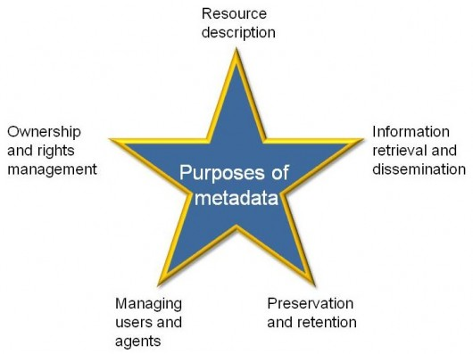
Some notes on metadata
Metadata = data about data
Traditional file metadata
Ownership
Permissions
Name
Disk location
Arbitrary?
Object storage metadata
Arbitrary key-value pairs
Permissions handled separately via ACL
(Re-)Creation time set automatically

Slide 52
Using metadata on the object storage
Needs to be accessed via the object API
E.g. set_metadata, get_metadata methods in Boto (more on this later)
obj_put, obj_get are examples – store (and retrieve) filesystem path for an object.
You might want to use metadata for…
Anonymized sample identifiers
Type of machine/analysis program used to generate the data
Any input paths, objects
Just about anything else you can think of that is not part of the object’s data itself!

Slide 53
Using metadata on the object storage
Needs to be accessed via the object API or via “-m” flag to obj_put
E.g. set_metadata, get_metadata methods in Boto (more on this later)
obj_put, obj_get are examples – store (and retrieve) filesystem path for an object.
You might want to use metadata for…
Anonymized sample identifiers
Type of machine/analysis program used to generate the data
Any input paths, objects
Just about anything else you can think of that is not part of the object’s data itself!
Could even have the whole pipeline command used to produce the object as metadata!

Slide 54
A practical example using the object store
Put raw data (gzipped fastq files) into the object store
Align the fastq files using STAR (read data directly from object storage)
Create bigWig coverage
Make coverage available via Genome browser
Visualize the data
Feel free to “work along” with me!

Slide 55
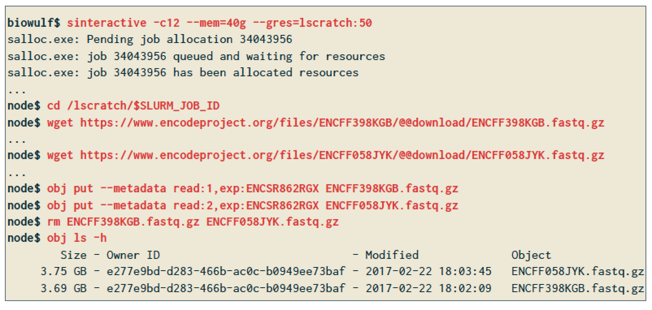
Putting example data into the object store

Slide 56
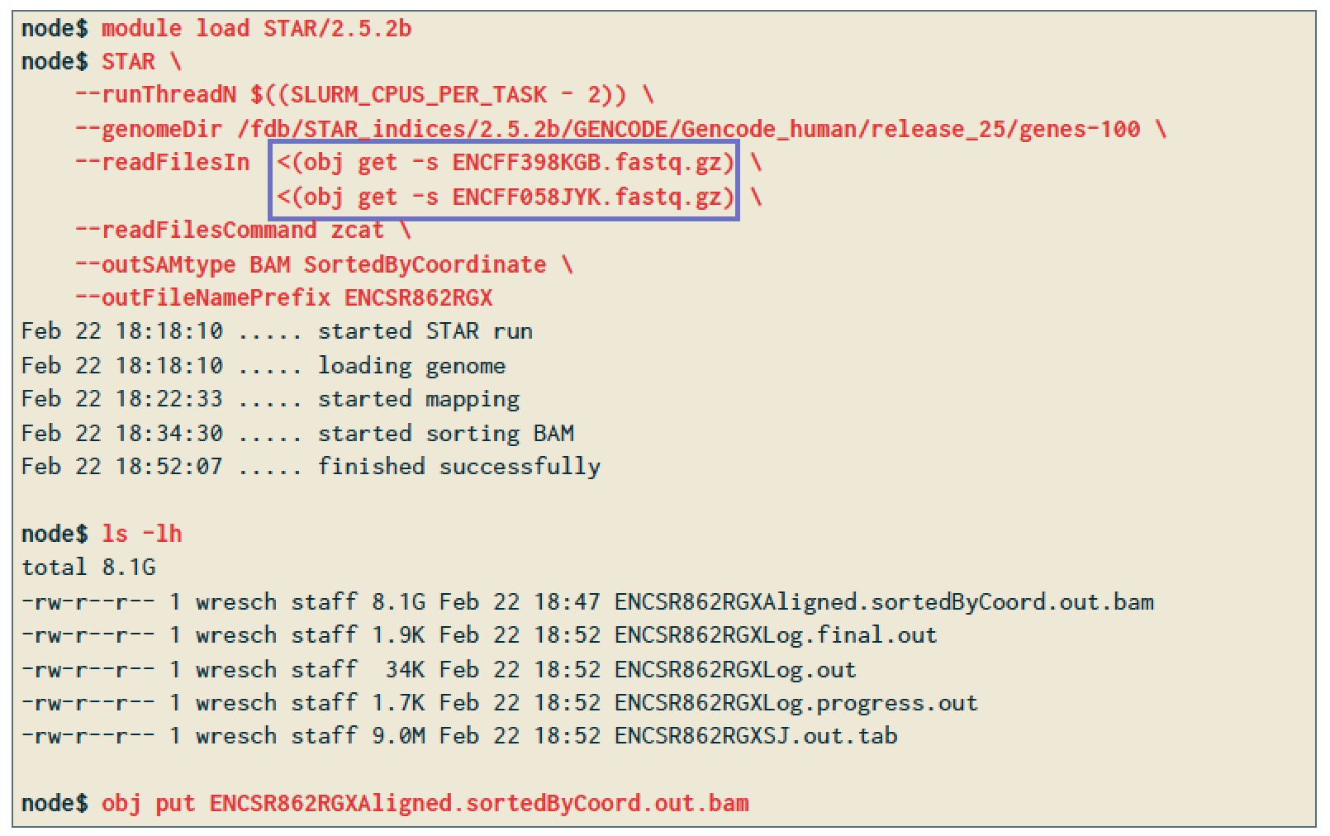
Align data from the object store with STAR

Slide 57
Align data from the object store with STAR
Note the use of input redirection combined with obj get

Slide 58
Create bigWig of coverage
Uses local output files from STAR
Puts results back on the object store for later access

Slide 59
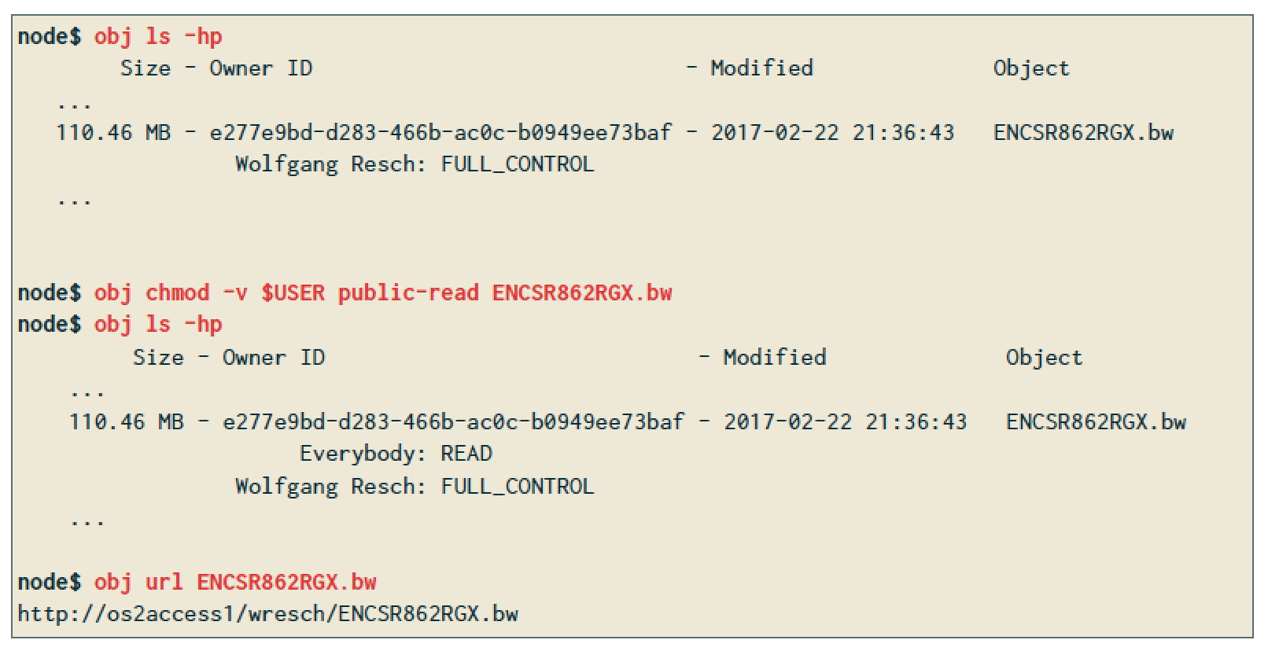
Make bigWig available to CIT genome browser

Slide 60
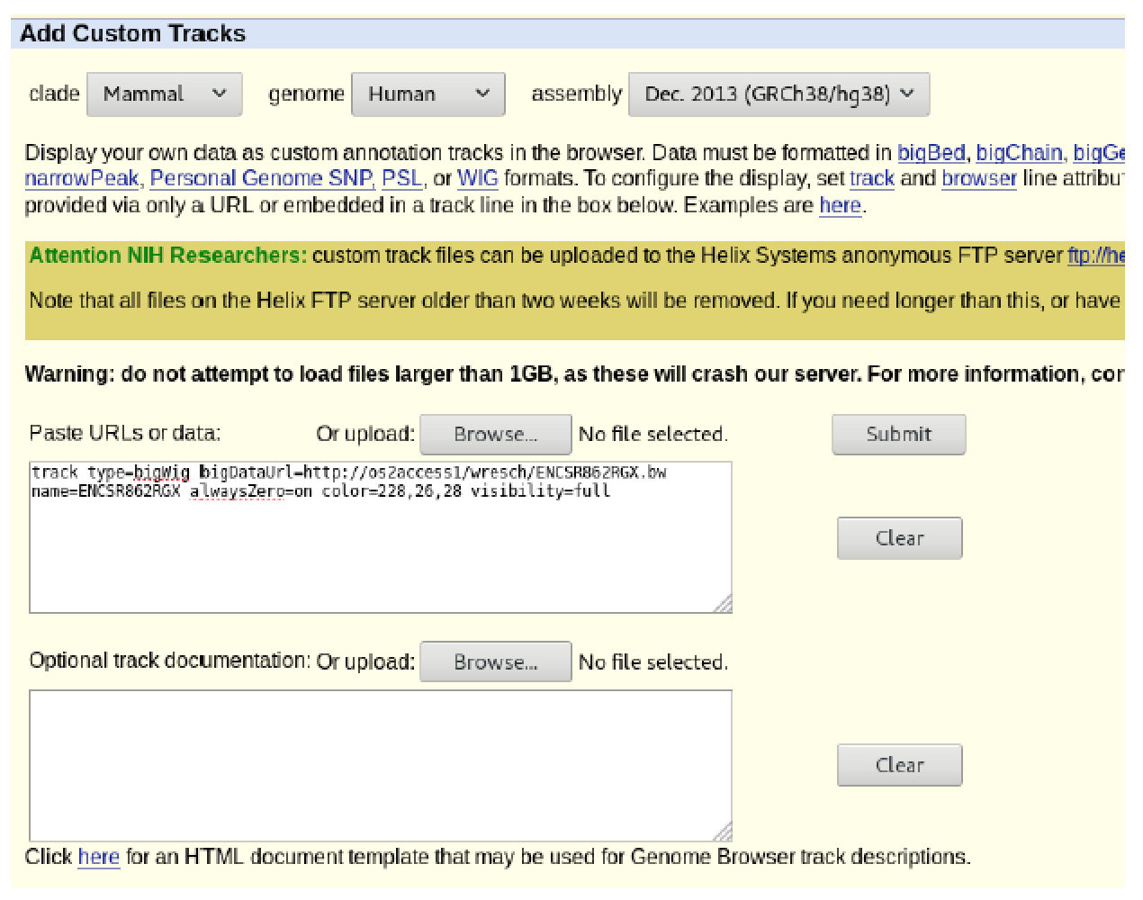
Visualize track

Slide 61
Visualize track
Use URL from ”obj url”!

Slide 62
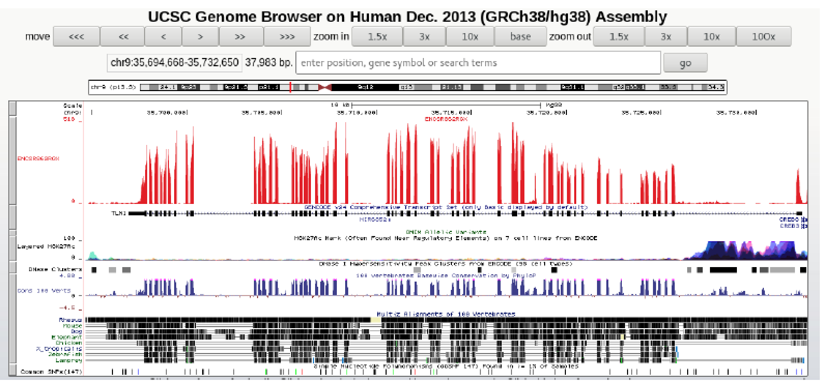
Visualize track

Slide 63
Outline
Overview of the object storage
A first practical example
When would you want to use object storage?
How do you get access to the object storage?
Using the NIH HPC object storage
HPC staff developed tools
Rclone
s3cmd
Programming your own tools

Slide 64
Programming your own tools
Why?
Need to customize functionality, e.g. reading metadata from objects.
Combining reading/writing data to object store with calculations.
Complicated access patterns – e.g. reading and writing multiple objects simultaneously.
Why not?
Requires knowledge of Python, Perl, Ruby, C++, etc.
NIH HPC developed object tools are all in Python – can use as examples
If existing tools satisfy your needs, there’s not much point
HPC staff fully supports “our” tools (and others like Rclone) – much less support for custom development

Slide 65
Programming workflow
Open Connection
(Need accessor address, credentials)
Open Vault/Bucket
(Need to know name)
OPTIONAL: List content
(can be slow)
Close Connection
OPTIONAL: operate on content (create key, get key, etc.)
May need to know object names

Slide 66
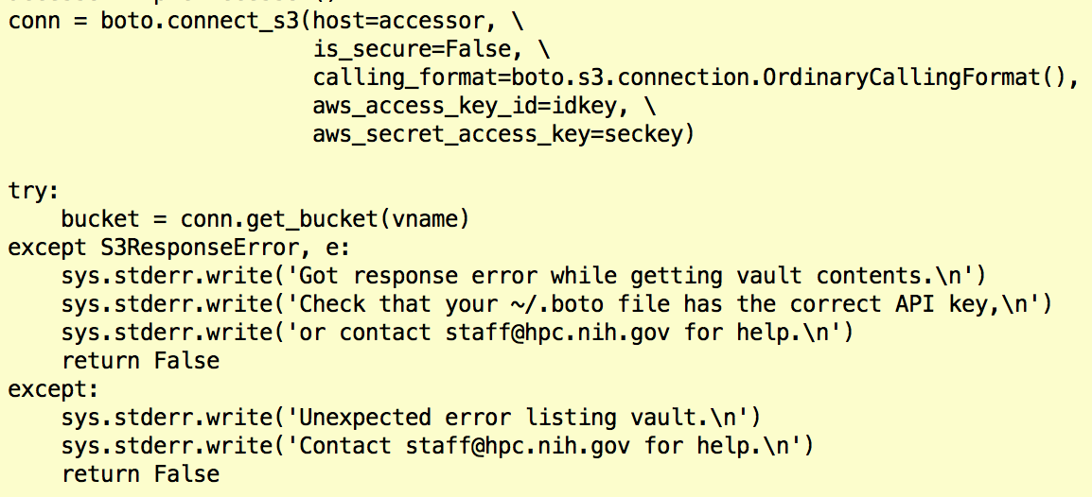
Programming in Python: Boto library
I’ve had more luck with boto v2 than boto v3
If you try boto3 and make it work, please let me know
Getting a bucket (vault):

Slide 67
Programming in Python: Boto library
I’ve had more luck with boto v2 than boto v3
If you try boto3 and make it work, please let me know
Listing contents:

Slide 68
Programming in Python: Boto library
I’ve had more luck with boto v2 than boto v3
If you try boto3 and make it work, please let me know
Deleting an object:

Slide 69
Programming in Python: Boto library
I’ve had more luck with boto v2 than boto v3
If you try boto3 and make it work, please let me know
Putting data:

Slide 70
Programming in Python: Boto library
I’ve had more luck with boto v2 than boto v3
If you try boto3 and make it work, please let me know
Getting data:

Slide 71
Programming in other languages
Amazon provides APIs to their Web services for many languages
Python, PHP, Perl, Ruby, JavaScript, and C++ (maybe others by now)
https://aws.amazon.com/code
Includes quite a lot of documentation, references, etc.
In principle, you can write pure API calls and pass them to curl/wget (or write your own HTTP), but this is really complicated.
Some tweaking is often necessary to make it work with the HPC object store
Can’t just connect to Amazon regions – need to specify an accessor
URL format is different (e.g. Amazon supports http://bucket.s3.aws.com)
HPC staff can provide advice, but software development is ultimately up to the user.

Slide 72
Wrap-up, summary
Object store is good for data that is…
Read-only in nature
Needs to be used regularly for computation
Only needs moderate performance
The object store cannot be used for…
Write-intensive data
Data that gets updated frequently
Archival data
Multiple different tools may be used to read and write data
You can write your own tools in a variety of programming languages

Slide 73
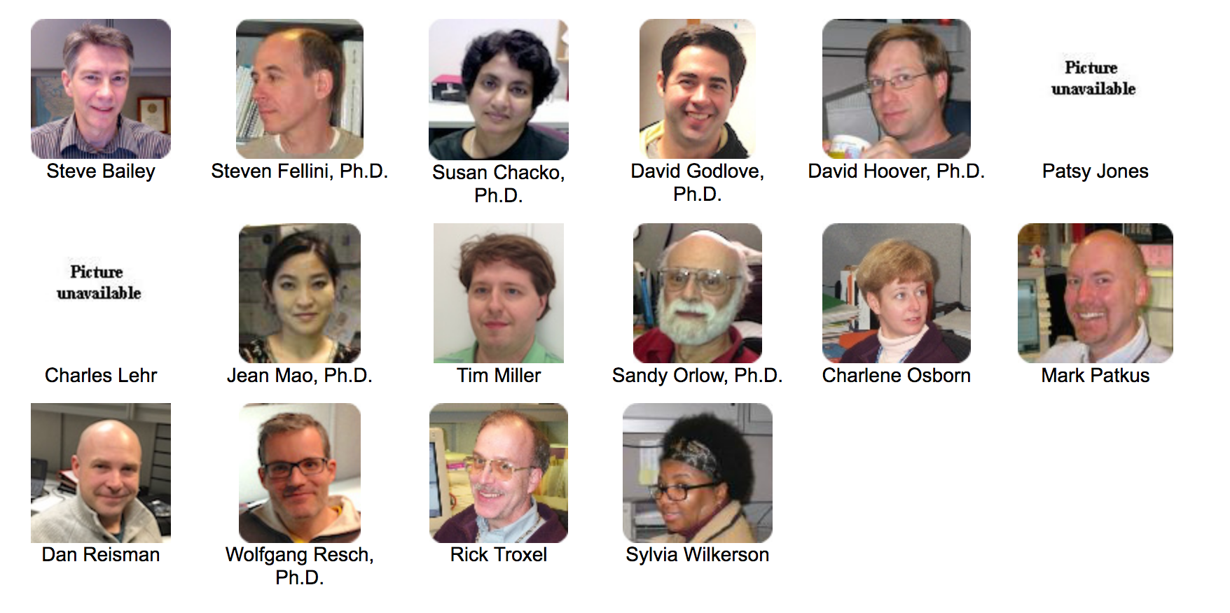
staff@hpc.nih.gov

Slide 74
Thank you
Thank you for attending
Please contact us with questions/feedback
Tim Miller – btmiller@helix.nih.gov
staff@hpc.nih.gov

